Slide 1

New Term, New Challenges, New Solutions!
Managing Transitions for Children with SEND
Ann Van Dyke MBE ann.vandyke@dingley.org.uk
James Brown james.brown@dingley.org.uk
https://dingley.org.uk

Slide 2
Agenda
Welcome and introductions
Who we are, why transitions and what we know
A parent perspective – Kirsty Penny, Calderdale parent
Big changes take small steps – Birmingham’s approach to strategically and continually improving transitions
Keeping it real in Calderdale – a systematic and relationship-based change program to improve transitions for children with SEND and Calderdale
Things we can all do next – shared learning in the chat
Feedback and summary
Close

Slide 3

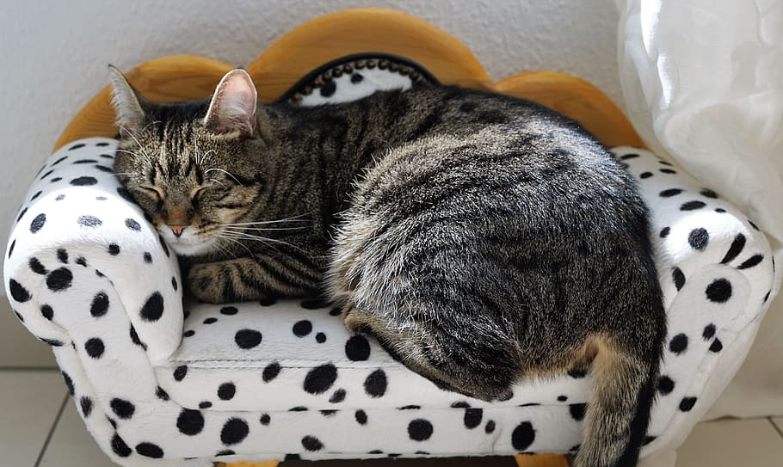
How shall we work today?
Cameras, mics, joining in and chat
Can you stop the clock and give yourself this time?
Are you comfy?
Please join in, (we get back what we give)
Who are we all? Please tell us in the chat!

Slide 4

Where this work comes from
Early Years SEND Partnership
DfE funded for 6 years now
LA strategic support, training, lunch breaks and webinars
https://councilfordisabledchildren.org.uk/about-us-0/networks/early-years-send/eysend-partnership

Slide 5

Who we are, and why we rock at transitions
Specialist early years provision for children with SEND & their families
Driving an inclusion movement across the country through training and local authority support (96%+ of practitioners tell us they can take more children with SEND after our training)
Influencing change nationally
Our transitions journey from 2015
https://dingley.org.uk
This Photo by Unknown Author is licensed under CC BY-SA-NC
Notes:
Working with children, families and mainstream providers
Thousands of transitions over 40 years
Working across the UK with LAs, providers, partners & parents
Representing children with SEND nationally and lobbying for change
Statement on inclusion/ shared provision/ EEP
Importance of family partnerships
Importance of practitioner wellbeing
35% to 65/70%

Slide 6
Our learning since 2015
Keep children central
Talk to parents but more importantly listen
Start before you start
Deliberately facilitate relationships and joint working
Senior management support counts
When we get it right for children with SEND, we get it right for all children
Processes to support
Practical ideas can be fun!
Evidence changing attitudes and confidence as well as outcomes

Slide 7
A parent’s perspective
An example of when things go wrong – Harriet from Somerset
What works? - Kirsty Penny from Calderdale

Slide 8

What do you think about what you’ve heard?
Please share in the chat

Slide 9

Case Study
Big changes take small steps!
Birmingham’s approach to strategically and continually improving transitions

Slide 10

Questions and what can YOU share?

Slide 11
Case Study
Keeping it real in Calderdale
A systematic and relationship based change program to improve transitions for children with SEND and Calderdale

Slide 12
Questions and what can YOU share?

Slide 13
Our learning from you
A strategic approach
Actively supporting joint working
Keeping families central
Informing and engaging wider partners
Measuring progress and outcomes

Slide 14

1. A strategic approach
An area wide transitions plan
Linkage to an overarching early years strategy, and your inclusion strategy
Ownership at a senior level
Establish measures
Raise and maintain a high profile in all your strategies and plans eg Family Hubs

Slide 15

2. Actively support joint working
Network meetings
Speed dating style events
Facilitated conversations
Share good practice
Think about processes e.g. our One Page Profile

Slide 16

3. Making sure families are central
Listening
Communicating (effectively)
Informing
Representation and feedback at every opportunity
Think child!

Slide 17

4. Informing and supporting all partners in the process
From processes to packs
Regular forums and communications
Use your strategic links to share messaging

Slide 18

5. Create a baseline and measure impact!

Slide 19

What can we all do to measure impact?
Parents and carers can equip themselves and share feedback
Providers and schools can follow up with families (and share the information to jointly plan improvements)
LAs can survey families in the autumn term and broker conversations
LAs can support EVERYONE to use our Entry Exit Pathway (or something like it!)
LAs can track complaints, deferred/pt entry, and track back take up data
LAs can join the dots with your overall data sets
  Measuring sufficiency
  Measuring impact

Slide 20

Question
What will you do to drive change?

Slide 21
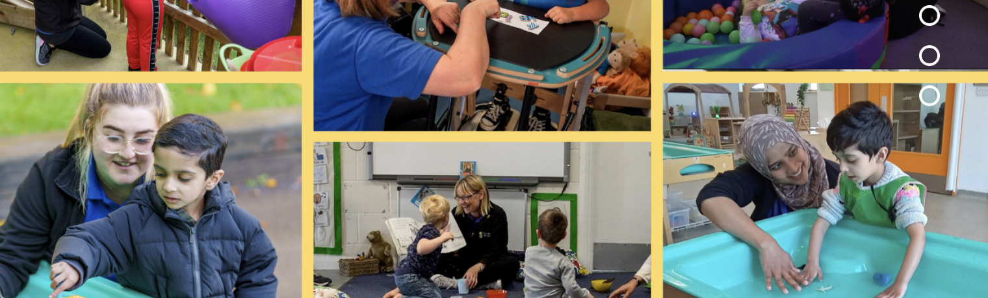
Next steps – get involved!
Join us for more events like this!
Link your local SEND Specialist providers with us to join the national forum
Share your ideas and concerns with us so we can pass on messages when we speak to MPs and influencers.
Sign up to hear our news and know first about webinars, events & opportunities

Slide 22

Finally…
Please leave us your feedback in the chat

Slide 23
Thank you for your hard work
and commitment to inclusion!

