Slide 1

Managing Good Transitions to Improve Outcomes for Children with SEND
https://councilfordisabledchildren.org.uk/about-us-0/networks/early-years-send/eysend-partnership

Slide 2


Agenda
An outline of who we are and what the support is about
A focus on transitions and what we know so far
Where are you now? A self review process to support a strategic plan
Action planning
Next steps

Slide 3

How shall we work today?
Cameras, mics, joining in and chat
We will make notes but not identify individuals
Can you give yourself this time?
Are you comfy?

Slide 4

Who are Dingley’s Promise?
- Established 1983 by parents of children with SEND in Reading
Specialist early years settings delivering learning through play
- Family support & outreach programme
- Reaching hundreds of families directly
- Upskilling thousands of practitioners (and 96% say…)
- National influencing to build wider inclusion
Notes:
Planning expansion to establish a cluster of four Centres in the north. Potential further Centres on the south coast.
Focus on advising DfE in changes to minimise negative effects on children with SEND
EY SEND is what we live and breathe – often SEND without EY or EY without SEND – we bring together
All Party Parliamentary Group – represent SEND
DCP/ SEC – represent the early years
National EY Specialist Providers Forum

Slide 5
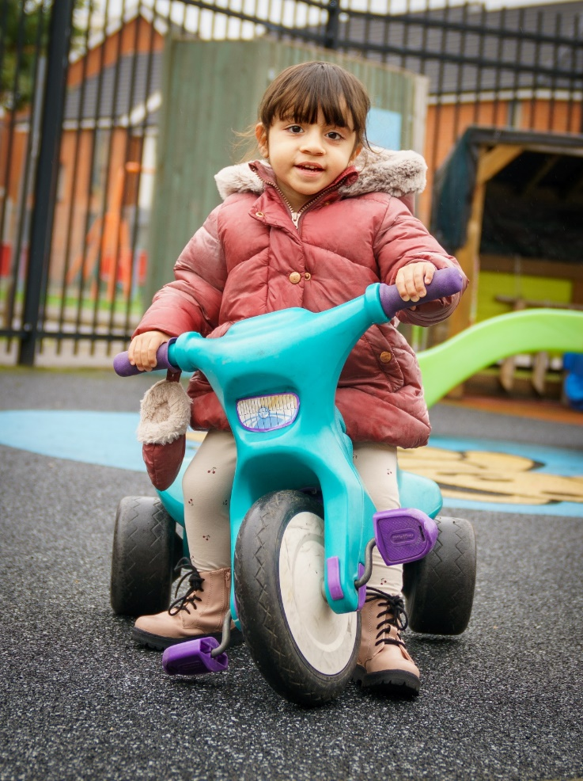
Training, consultancy and influence
Our HUGE Comic Relief funded Programme
DfE providers list to advise on EY SEND Conferences Nursery World, TES etc.
Creating guidance – EEP, Data driven approach, new EYFS SEND guidance
Lobbying and campaigning for change
www.dingley.org.uk
Notes:
In January 2018 launched Level 3 in EY Inclusive Practice with ncfe
Lockdown – inclusion training 737 across UK – invited to join partnership
We deliver at our three Centres so training grounded in experience
Support for LAs and other organisations to promote inclusion in the early years

Slide 6


Our work with each of you 3 x Action Learning Sets 100 training places Monthly Inclusion Lunch Breaks National events Check ins and peer support with us and all LAs we are currently supporting through this project Connections to other EYs SEND Partners?

Slide 7

A word about training engagement
How are you doing?
What are you doing?
What might help?

Slide 8

Update on Data
Local Authority | August Learner Uptake
Dudley | 96
Redcar & Cleveland | 18
Sunderland | 4
Blackpool | 2
York | 2
Middlesborough | 0
Wolverhampton | 0
Total | 122

Slide 9

So what works in supporting training take up?
Our regular top tips from our existing partners…
Get help!
Regular comms and branding awareness “ask me about Dingley’s”
Face to face (and systems to prompt you)
Events and conferences
Book ends and wall paper!
Celebrate your champions but…
…Avoiding the honey pot effect
Reward systems – eg our Mark of Achievement
Parent power!
Celebrate success and create new norms
Above all, keep it positive and have fun!

Slide 10

So what about transitions?

Slide 11
Why are transitions important for children?
Independence
Resilience
Self esteem
Fitting in and a sense of belonging
Moving through change in life

Slide 12
Why else are transitions important?
For settings
For schools
For the family
For society
For the future

Slide 13

So what were the common challenges for transitions?
A strategic approach was often missing
Joint working between settings and schools can be a challenge
Parents (and children) should be central
Schools and wider partners should be informed
Measuring change is key

Slide 14

1. A Strategic Approach Was Missing Raising the profile of the early years within local authority agendas

Slide 15

What could it look like?
An area wide transitions plan
Linkage to an overarching early years strategy, and your inclusion strategy
Ownership at a senior level (lead member and schools forum)
Establish measures and the business case
Using score cards
Budgets that reflect priorities
Raise and maintain a high profile in all your strategies and plans eg Family Hubs

Slide 16


Slide 17
What a strategy could look like?
An early years and childcare strategy with inclusion as central throughout and which…
Refers directly to our legal duties and risks of legal challenge (specifically the Childcare Act 2006/16)
Relates to strategies which support and are supported by early years and early years inclusion eg safeguarding, savings, attainment, regeneration etc
Directly references the Best Start and Family Hub agendas

Slide 18

Where are you?

Slide 19
2. Strengthening the relationship between early years and schools
Bringing educators together for better transitions

Slide 20
What is the issue?
- early years settings report schools not valuing their information
- early years settings report schools not engaging in the transition process
- schools report early years settings not giving them useful information
- schools report children arriving with no warning of SEND from settings
- general lack of trust between early years and schools
What are the issues?

Slide 21
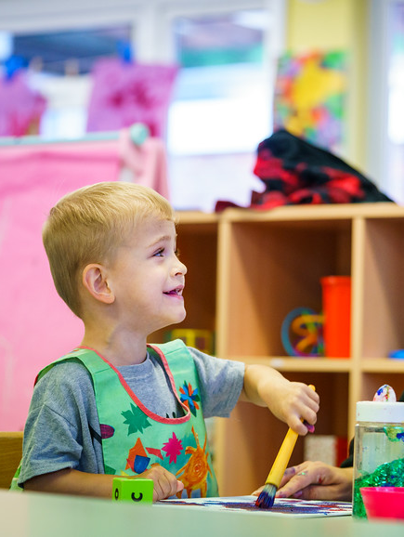
What’s working?
Schools need to see early years leaders represented in decision making and strategic discussions eg Schools Forums.

Slide 22

Things you can do to actively support joint working
Inductions
Network meetings
Speed dating style events
Facilitated conversations
Share good practice
Think about processes eg our One Page Profile

Slide 23
Where are you?

Slide 24
3. Putting parents at the heart of the transition process
An informed family can make the best decisions

Slide 25
Parent carers tell us… “transitioning to school is hard for us and our children”
“It was difficult. The school didn't ask for a history on the child after he was awarded a place at the school, I had to call them to make it known. And then once he started it came to light that not much of that history had been passed on from the Early Years lead to the class teacher. The transition was really difficult for my son and stressful for us as parents.”

Slide 26
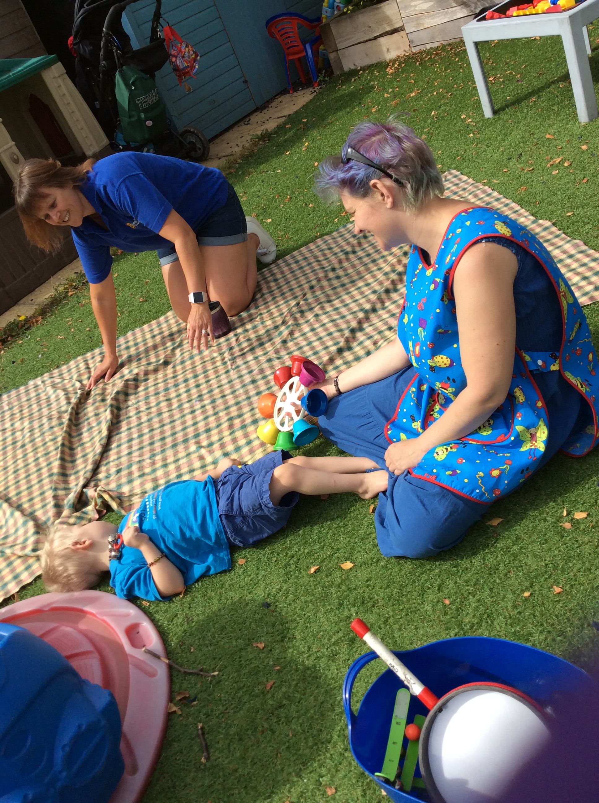
Parents’ messages
Listen to us
Make sure we always know who to talk to
Know and consider our whole family
Help us to get an EHCP in place
Always keep us informed

Slide 27
Ideas for better transitions for parents
Create
- Create case studies of good child outcomes
Start
- Start transition discussions with family as early as possible
Do
- Share activities families can do at home to help transition
Use
- Use social media to provide peer and professional support
Link
- Link to local SEND parent voice groups

Slide 28
Where are you?

Slide 29
4. Schools and wider partners should be informed

Slide 30

Informing and supporting all partners in the process
From processes to packs
Regular forums and communications
Use your strategic links to share messaging

Slide 31
Where are you?

Slide 32

5. Measuring success

Slide 33

What can you do?
Parents and carers can share feedback
Providers and schools can follow up with families (and share the information to jointly plan improvements)
Providers and schools can use our Entry Exit Pathway
Quick surveys with providers, schools and families
LAs can Track complaints, deferred/pt entry
LAs can join the dots with your overall data sets
Measuring sufficiency
Measuring impact

Slide 34
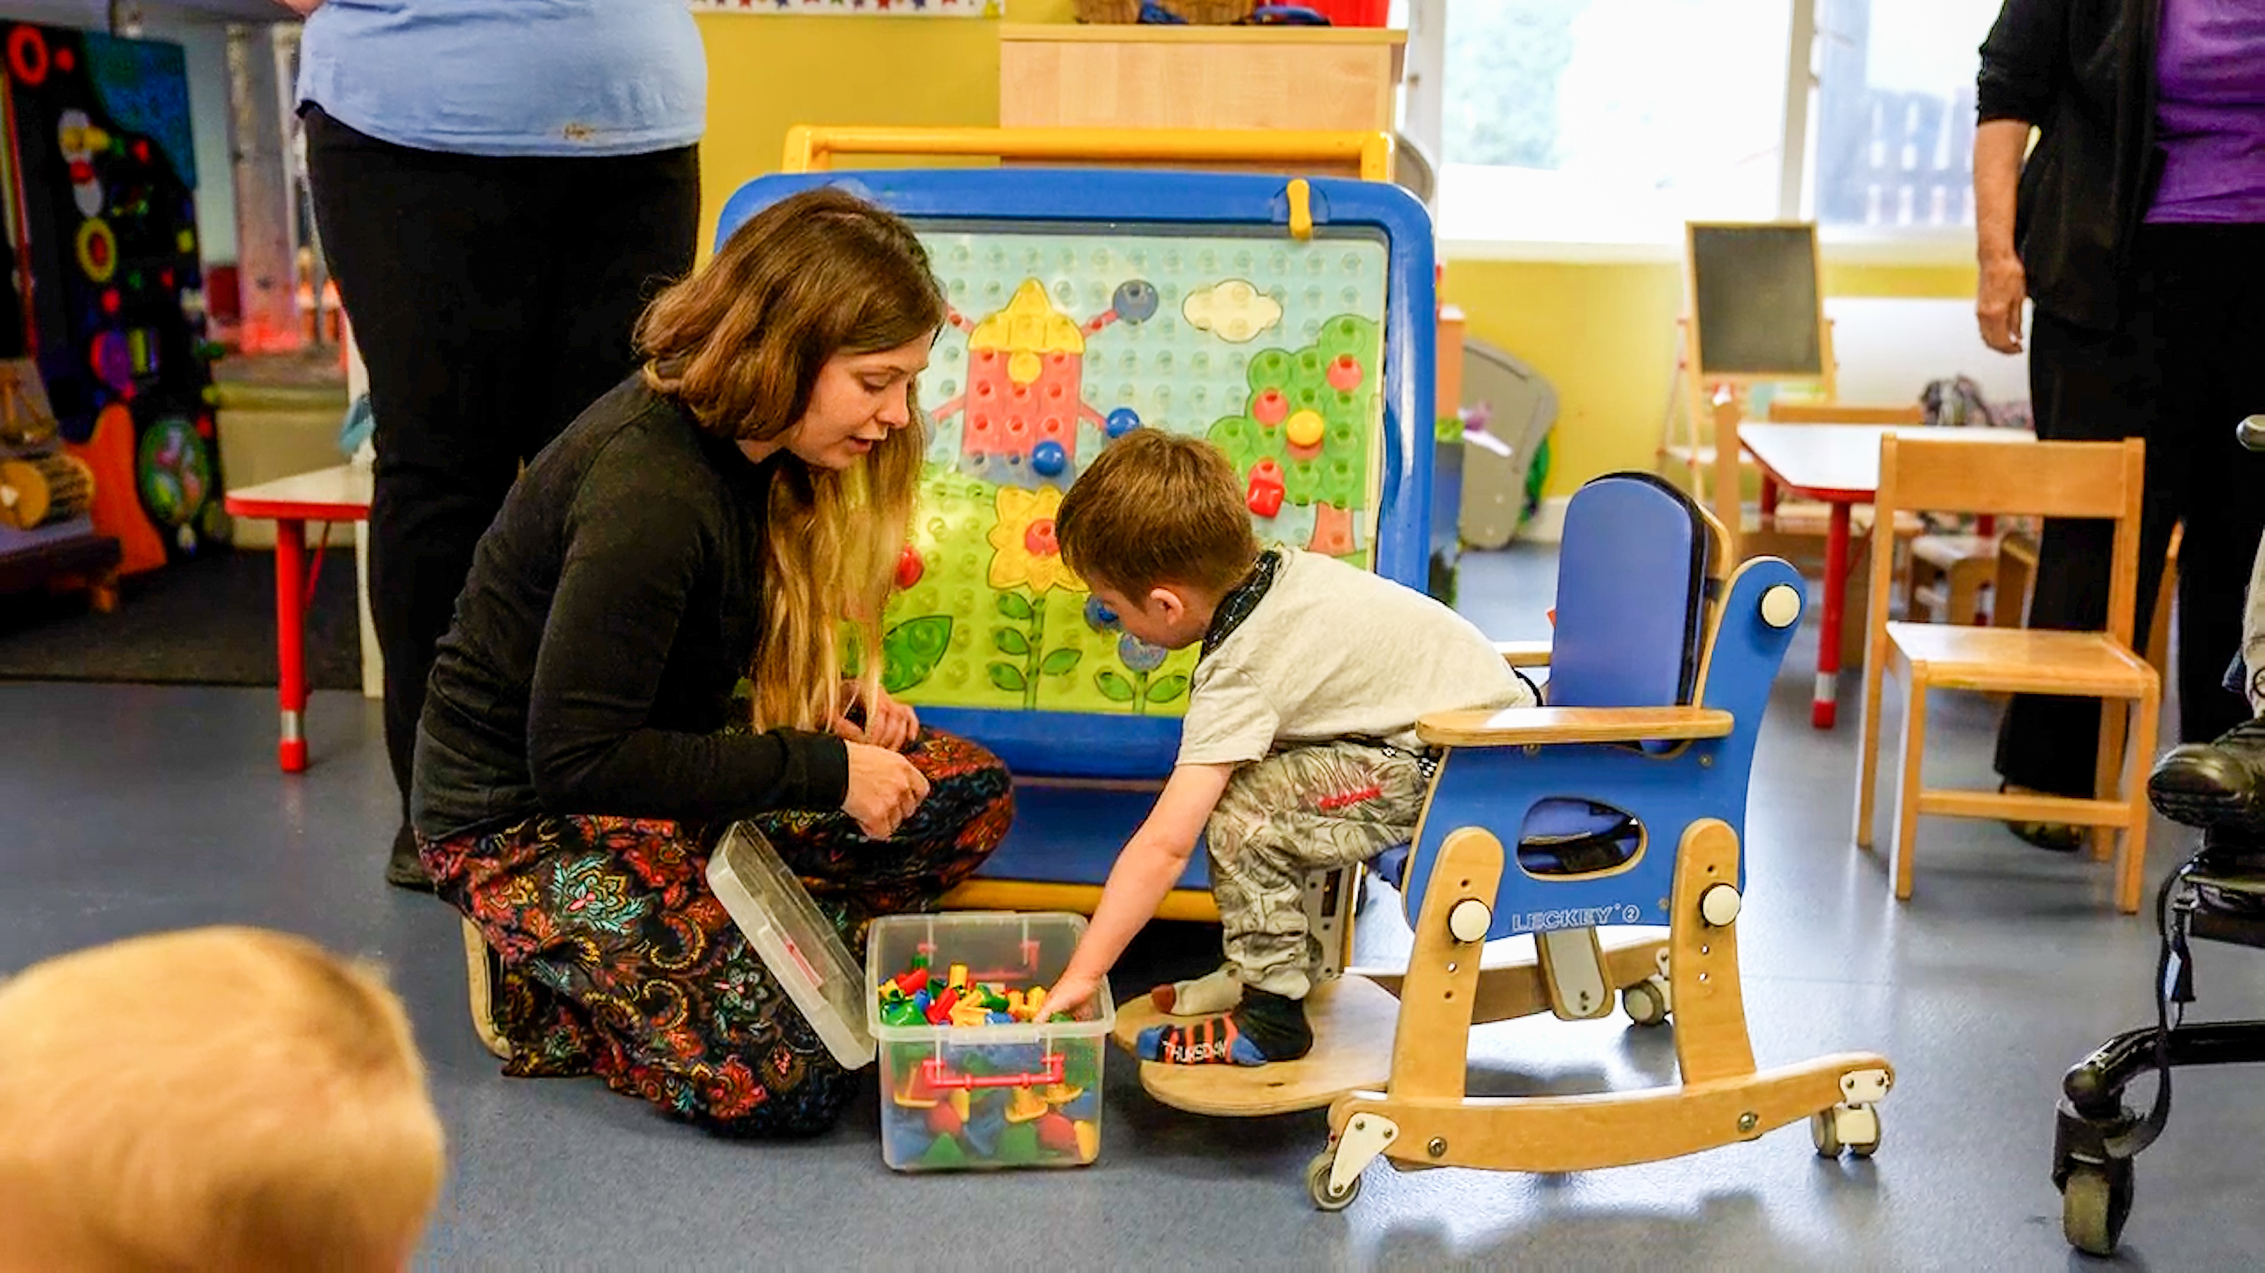
And our Entry Exit Pathway?
Huge demand from parents for our service
Concerns from LA about which children attending
Lack of parental knowledge and anxiety about transition process
Assumption once children are with us, they stay with us
Resistance when trying to move children to the mainstream
Lack of process to evaluate success of our transitions
https://dingley.org.uk
Notes:
Why did we develop this tool?
Response to these issues.

Slide 35
Where are you?

Slide 36

Practice ideas from providers in Calderdale
Start before you start!
Going to School Role play, incl uniforms/ photos of local schools
Virtual visits & routes to and from school /community
Meet the Teachers sessions both real and virtual
Reception Staff reading story or talking about coming to classroom (recorded)
Tea & Tissues for parents at PVI setting on first day of school

Slide 37

Practical ideas used in Slough
School uniform/ bookbags - dress up clothing & ‘classes’ for imaginative role play
Social stories
Mutual visits between pre-school/EY setting and school, including key EY staff
Postcards sent by key person in receiving school to families in summer holidays – similar to one page profiles
Videos of setting environment, including one taken at children’s eye level height – shared on websites
Meetings with families – online format
Garden/outside spaces used for settling visits
Walk or drive the route to the new school/setting – familiar sights
EYIG – application for supported transition visits
Shared sites – regular visits with small groups of children in spring & summer term
Families stay during settling visits in comfortable environment – including younger siblings
Family picnic days – start in school field and encourage continuation in local park – whats app groups
Meeting in Spring term with parent’s to talk in ‘safe space’ about any anxieties for moving to new school.
Notes:
Talk through key points and share examples

Slide 38

What will you do next? Self Evaluation Action Planning Sharing with us Join our events

Slide 39

Thank you for your continued commitment and passion!
Ann Van Dyke MBE ann.vandyke@dingley.org.uk

