Slide 1


Dingley’s Promise
Changemakers Early Years Inclusion Project
Stakeholder Group
Spring 25

Slide 2

Welcome, introductions and housekeeping
Names
Cameras and mics
Chat
Are you comfy?
Can you give yourself this time?
Notes and actions
Who are you?

Slide 3
Aims and agenda
A reminder about who we are, what the project is about,
and how we can all action plan for success…
Introductions, welcome and housekeeping
A word about parent carer representation
Summary of next steps and feedback in the chat
Introduction to Dingley’s Promise and reminder about the project
What we are doing and how else can we help?
Scores on the doors
What is happening locally for you?

Slide 4


Who we are, and what we do
A charity delivering specialist nursery provision for children with SEND
  Working with children, families and mainstream providers
  Thousands of children and families supported over 40 years
  35% to 70% transitions to the mainstream
A will to drive an inclusion movement
  Working across the UK with LAs, providers, partners & parents
  Lobbying for change nationally representing their voices

Slide 5
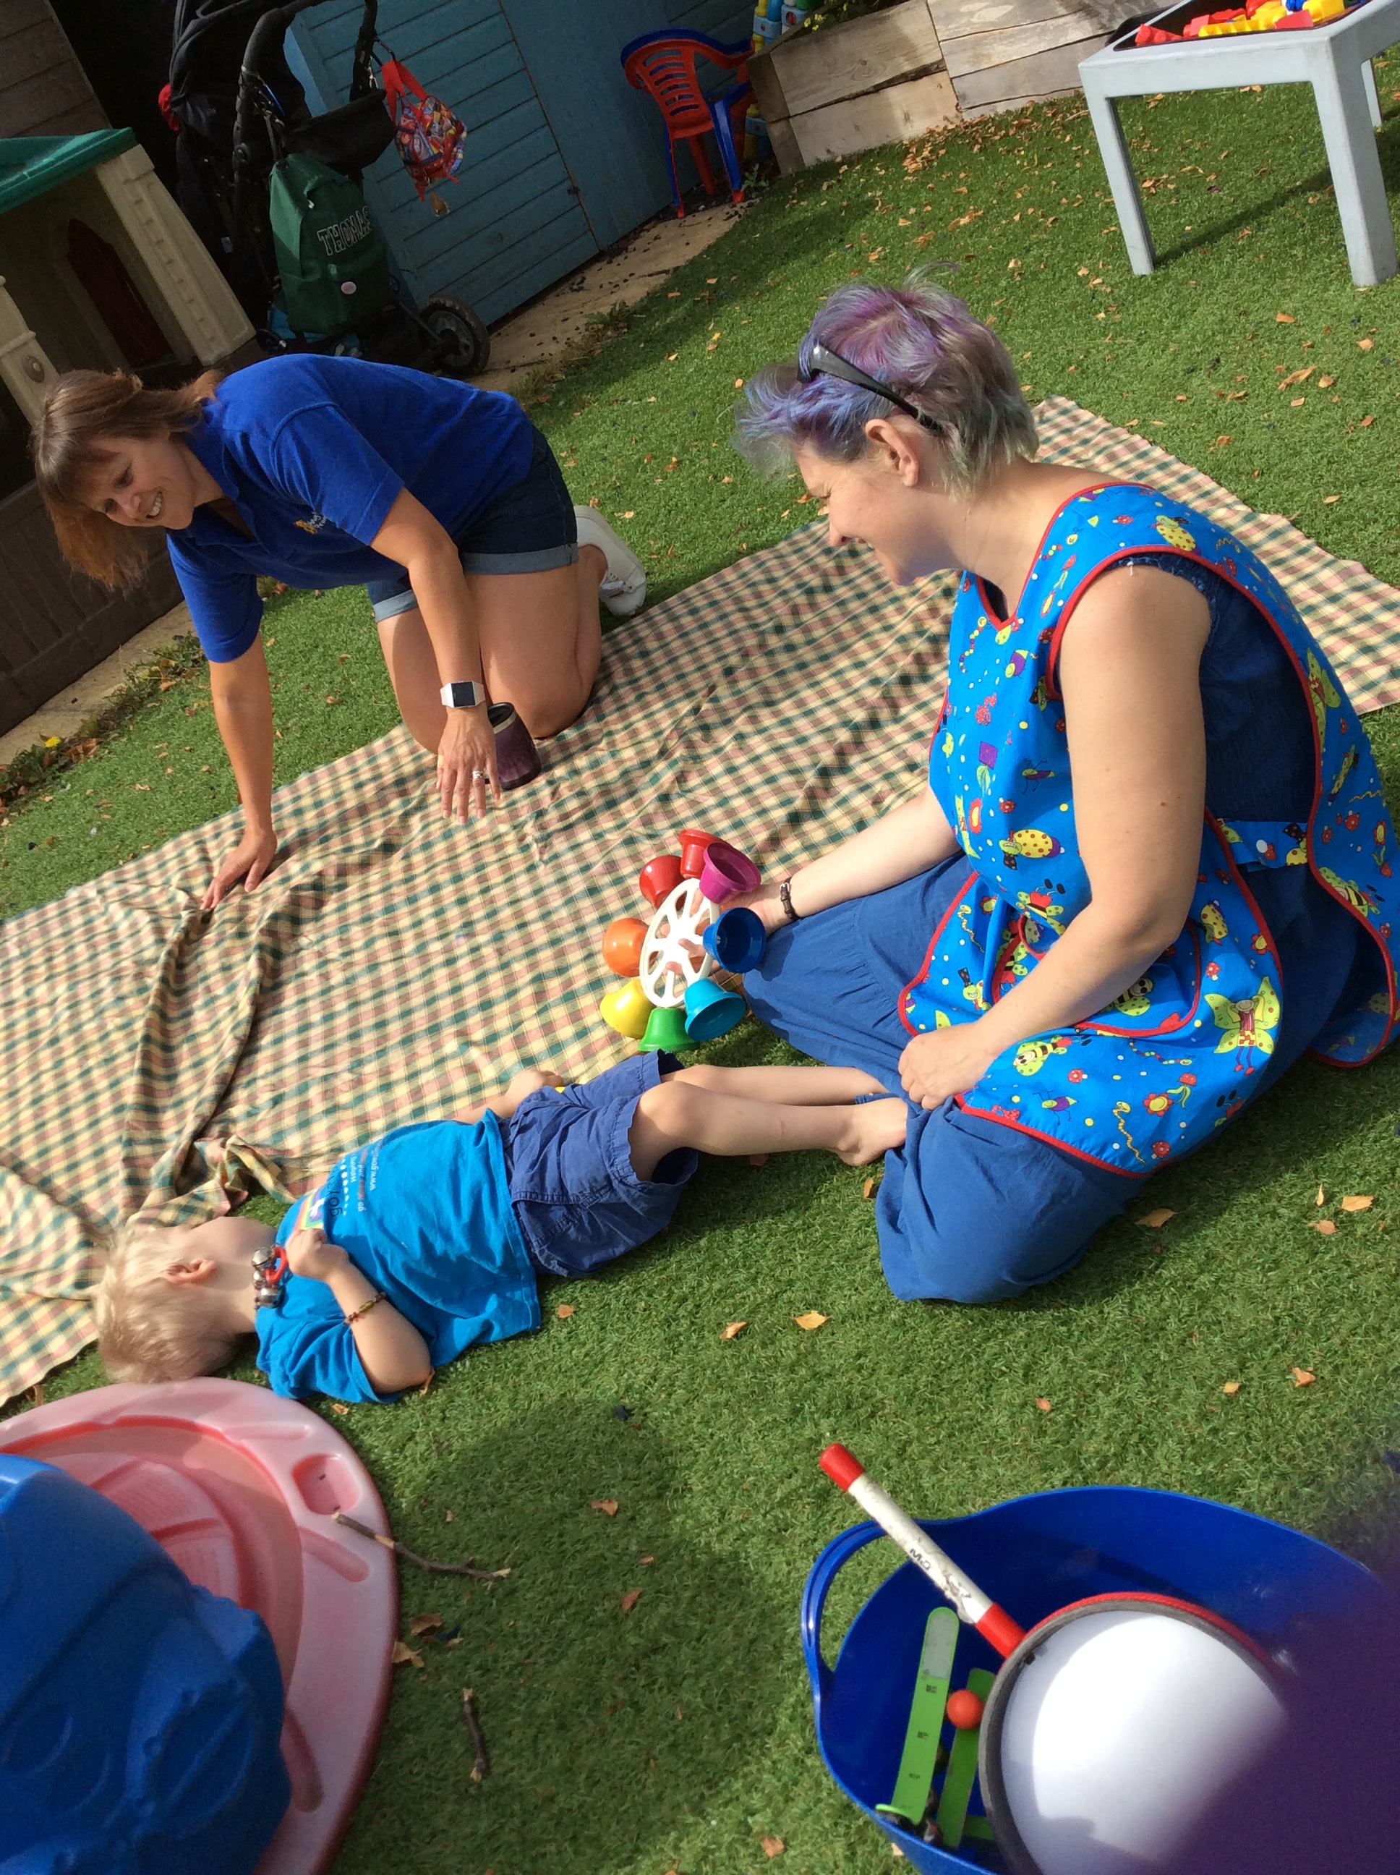
Why the Comic Relief bid?
Children with SEND are not taking up early years and childcare entitlements to the same extent as their peers
There is a shortage of inclusive places
Research shows training and confidence are critical barriers
We want to make a difference!

Slide 6

The aim of the project is…
…to increase the number of young children with SEND accessing early years and childcare places through...
Partnership with Local Authorities
Meaningful Parental Engagement
A National Steering Group
A Comprehensive and extensive training offer we know makes a difference
Notes:
-

Slide 7

What’s in it for your area and why now more than ever?
A chance to do the right thing and address a significant inequality
Legal compliance in securing sufficient early years and childcare places for children with SEND, both measuring it and taking reasonable steps
Approximately £.5 million workforce investment in your area
Supporting more families to access universally inclusive places (helping meet increased demand for support)
Parent/carer representation in the early years
Potential spin offs?
  Parent led services?
  Improved delivery for over 5s out of school too?

Slide 8

Skilling up the workforce through a comprehensive and extensive training offer
Online training for the whole early year's workforce (aiming to reach 30,000 practitioners)
10 courses which are:
- online
- flexible
- support individuals and can be completed as a team
- aimed at supporting confidence, skills and
practical ideas

Slide 9

https://dingley.org.uk/dingleys-promise-training/comic-relief/

Slide 10

What is happening for you right now?
LA wide priorities?
Children’s service priorities?
EYs and Childcare priorities?
EYs Inclusion priorities?
Sector concerns and pressures?
Issues and concerns for families?

Slide 11

What does your data tell you and what will you do next?

Slide 12

So what works in supporting training take up?
  Our regular top tips from our existing partners…
  Plan! Many hands make light work
  Branding awareness and the background noise eg email signatures, lanyards, flyers, newsletters, emails but…
  Face to face tips people into action eg conferences, forums, networks, 1-1 visits
  Embed messaging in your day-to-day contacts
  Celebrate your champions and create new norms
  Reward systems eg our Mark of Achievement
  Sector specific messaging
  Member engagement
  Parent power
  Use our tools and resources eg social media pack, top tips, planner etc
  Above all, keep it positive and have fun!

Slide 13
What about training completions?
/
What are the challenges?
What are you doing to address them?

Slide 14

How do we drive training completions?
Ideas from our other areas…
Celebrate success – publicly and individually
Mark of Achievements?
Parent power
Timing and spin
Contracts and commissioning
Incentivise
Create deadlines
Create norms
Offer time and space

Slide 15
https://dingley.org.uk/dingleys-promise-training/comic-relief/

Slide 16

The ways our parent/carers impact
Parent/carer experts to advise us all throughout – keeping it real!
Increased awareness of the project and training
Demand led change across the whole area
A lasting legacy – parent led services?
A great team of parent/carers to work (and have fun) with!

Slide 17

Meaningful parental engagement – you said we did!
What we now do…
A welcome email and role profile
Induction (welcome) to support confidence and skills
Regular informal parent carer meetings
Our fortnightly coms
A dedicated Facebook Group to grow connections and share ideas
Engagement in local stakeholder groups
Representation in the overarching national project steering group

Slide 18

Partnership with parent carers, what will you do next ?
Recruit or refresh your parent/carer reps
  Parent/Carer Council?
  Direct mail outs?
  Social media?
  Provider contacts?
  Think about families of families too (eg grandparents)
Pass on their details to us
Recruit at least 1 or 2 but basically as many as you like!

Slide 19

What are we up and how else can we help?
Marketing and coms
Direct contact with leaners
…and
Inclusion Lunch Breaks
Webinars and events
Papers to support you
New centres
Our national presence

Slide 20

Summary of next steps
Update your baseline data re providers and practitioners
Think parent/carer representatives
Share the parent surveys
Continue developing your marketing plan, using the lessons from everyone else
Think about supporting completions
Join our events to hear about and share what’s working
What will you do next?

Slide 21

What will you do next?

