Slide 1

Transitions for Early Years Children with SEND
How do we know what works?
Catherine McLeod MBE catherine.mcleod@dingley.org.uk
Ann Van Dyke MBE ann.vandyke@dingley.org.uk
https://dingley.org.uk

Slide 2

Agenda
Who we are and what we do
A parent carers perspective – when transitions go wrong
Highlights of the last 6 years, what we collectively learnt
Case study Bournemouth Christchurch and Poole – data driven change and the journey to ensuring the best impact and outcomes
Case study Norfolk - what works and our process of measuring impact
A parent carers perspective – when things go well and what works
What are you doing to drive change and measure impact?
What will you do next?

Slide 3

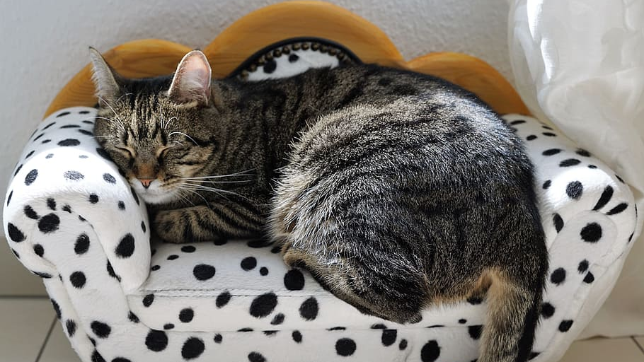
How shall we work today?
Cameras, mics, joining in and chat
Can you stop the clock and give yourself this time?
Are you comfy?
Please join in, (we get back what we give)
Who are we all? Please tell us in the chat!

Slide 4

Where this work comes from
Early Years SEND Partnership
DfE funded for 6 years now
LA strategic support, training, lunch breaks and webinars
https://councilfordisabledchildren.org.uk/about-us-0/networks/early-years-send/eysend-partnership

Slide 5

Who we are, and why we rock at transitions
Specialist early years provision for children with SEND & their families
Driving an inclusion movement across the country through training and local authority support (96%+ of practitioners tell us they can take more children with SEND after our training)
Our transitions journey from 2015
https://dingley.org.uk
This Photo by Unknown Author is licensed under CC BY-SA-NC
Notes:
Working with children, families and mainstream providers
Thousands of transitions over 40 years
Working across the UK with LAs, providers, partners & parents
Representing children with SEND nationally and lobbying for change
Statement on inclusion/ shared provision/ EEP
Importance of family partnerships
Importance of practitioner wellbeing
35% to 65/70%

Slide 6
Measuring Transitions – Why?
We all have to manage change throughout our lives and need to know what works!
Multiple disadvantage matters
To justify and use resources effectively
To know what works and repeat!

Slide 7
When transitions go wrong
a parent perspective

Slide 8

What do you think about what you’ve heard?
Please share in the chat

Slide 9
Our learning since 2015
Keep children central
Talk to parents but more importantly listen
Start before you start
Deliberately facilitate relationships and joint working
Senior management support counts
When we get it right for children with SEND, we get it right for all children
Processes to support
Practical ideas can be fun!
Evidence changing attitudes and confidence as well as outcomes

Slide 10

Addressing the common issues
1. A strategic approach
An area wide transitions plan
Linkage to an overarching early years strategy, and your inclusion strategy
Ownership at a senior level
Establish measures
Raise and maintain a high profile in all your strategies and plans eg Family Hubs

Slide 11

Addressing the common issues
2. Actively support joint working
Network meetings
Speed dating style events
Facilitated conversations
Share good practice
Think about processes eg our One Page Profile

Slide 12

Addressing the common issues
3. Making sure families are central
Listening
Communicating (effectively)
Informing
Representation and feedback at every opportunity
Think child!

Slide 13

Addressing the common issues
4. Informing and supporting all partners in the process
From processes to packs
Regular forums and communications
Use your strategic links to share messaging

Slide 14

Addressing the common issues
5. Create a baseline and measure impact!

Slide 15
Case Study from Bournemouth Christchurch and Poole – setting the scene, developing an evidence base for change

Slide 16

Questions and what can YOU share?

Slide 17
Case Study from Norfolk – measuring transitions

Slide 18


Norfolk Early Years Transitions
The Norfolk landscape
Jenny Howell & Ruth Toop – EYFS SEND Advisers
Norfolk County Council
Safety valve = Local First Inclusion
NASAPs
4 FTE Early Years Advisers
Focus on SEND transitions to school today

Slide 19

Norfolk Early Years Transitions
Early Years data context
Seeing increases in:
  SENIF
  EIN
  EY EHCP’s
  PEX & exclusion risks for Reception children
  Delayed and deferred school starts
  Appeals
  Tribunals

Slide 20
Norfolk Early Years Transitions
A matrix of targeted activity to improve transitions
STAIR - Supporting transitions and inclusion record
Communication Hubs
EY SENCDO Networks
Best School Start
SCT support
EHCP Consultations
Bridging Fund
Notes:
Collaborating with sector to coproduce resources eg STAIR & Padlet
Communication Hubs developed across the county in localities to strengthen partnership support for C&L
Professional development - SENDCO networks
Training - Best School Start
SENIF data was used to identify children who may benefit from transition support and SCT’s offered some transition drop-ins that were held for families over the Summer term and individual family work was undertaken over the Summer holiday period.
Early Years Advisers contacted all providers with children that had EHCP’s following school spaces being allocated (Feb/March)
Approaching 3rd year of providing targeted funding to schools based on intelligence about children before they start school. This identifies those children with the highest level of need, with an expectation that it will be used to facilitate transition arrangements.

Slide 21
Norfolk Early Years Transitions
Monitoring impact data
Professional development – monitoring attendance
Padlet of resources – anecdotal feedback
Closer working with Admissions, SEND & Inclusion teams
Data sharing with partners to identify exclusion risks
2 yr checks & EIN – early intervention flags
Support services e.g. Portage, EAL, SEND, LAC
SMAAG Audit – Quality Assurance activity
Use of Norfolk STAIR…

Slide 22
Norfolk Early Years Transitions
What data does the STAIR communicate?
Over 2000 STAIRs have been completed via the NCC hosted online form and many more paper copies
Children with SEND are more likely to have a STAIR completed
SENIF, DAF, PP, EAL, EHCP status
Support plans, care plans, risk assessments are shared
SALT, Portage, OT, PT, HV, GP & other specialist contributions
Expected or Emerging in the 8 sub-sections of the prime areas
Quadrant of need: C&I, SEMH, P&S, C&L
Tracking trends over 3 years

Slide 23
Norfolk Early Years Transitions
Impact of intelligent data-led approach
What do we know? | How do we know it?
Children with EIN have more than double the persistent absence than all Norfolk children | EIN & school attendance
More than half of children with an EIN go on to have an EHCP | EIN & EHCP data
Take up of early entitlement closely matches for children with or without SEND | EE & SENIF data
Children with SEND who attend a CM have better outcomes at FSP | FSP & EE data
Boys with SEND are at significantly greater risk at point of transition than girls with SEND | SMAAG & Attendance data
Over a quarter of EY settings where vulnerable children attended did not share a transition record with onward school | SMAAG audit
Children with an EHCP are more likely to experience a poor transition | SMAAG & EHCP data
Children transitioning into specialist provision have smoother transitions and are at less risk of PEX | SMAAG & PEX data
Only 11% of the settings & schools involved in the transition of the vulnerable cohort had access Dingley’s Promise Transition Training. | SMAAG & Dingley’s data

Slide 24
Norfolk Early Years Transitions
What have we learned about SEND transition data?
Data gathering, monitoring & analysis is only of value if it brings about tangible changes in transition experiences
Data should be communicated with all those involved
Data can tell a chapter of the story, if not careful
Data enables us to understand our impact & effectiveness
Data is used to evolve our offer of support around transitions
Data empowers us to present robust challenge
Data generates some answers, but more questions!

Slide 25
Questions and what can YOU share?

Slide 26

What can we all do?
Parents and carers can equip themselves and share feedback
Providers and schools can follow up with families (and share the information to jointly plan improvements)
LAs can survey families in the autumn term and broker conversations
LAs can support EVERYONE to use our Entry Exit Pathway (or something like it!)
LAs can track complaints, deferred/pt entry, and track back take up data
LAs can join the dots with your overall data sets
  Measuring sufficiency
  Measuring impact

Slide 27
What can YOU share?

Slide 28
When transitions go wrong and what could have helped
a parent perspective

Slide 29

Question
What will you do to drive change?

Slide 30
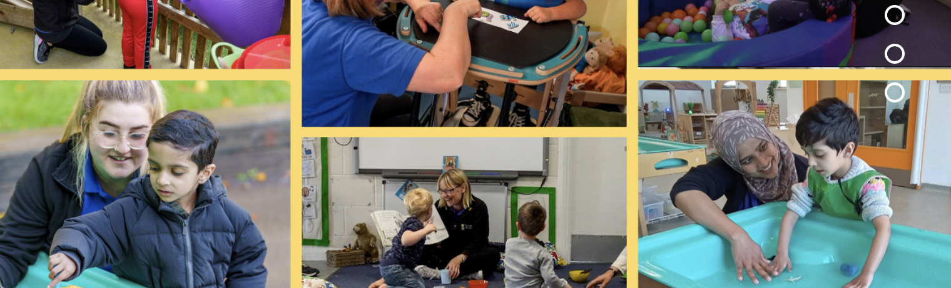
Next steps – get involved!
Join us for more events like this!
Link your local SEND Specialist providers with us to join the national forum
Share your ideas and concerns with us so we can pass on messages when we speak to MPs and influencers.
Sign up to hear our news and know first about webinars, events & opportunities

Slide 31
Catherine McLeod MBE catherine.mcleod@dingley.org.uk
Ann Van Dyke MBE ann.vandyke@dingley.org.uk
Thank you for your hard work
and commitment to inclusion!
Feedback please in the chat

