Slide 1
Welcome to our Inclusion Lunch Break!

Slide 2
Agenda
Introductions and welcome
You said we did (a round up from last time and what next)
A spotlight on funding for inclusion
Streams available to LAs and the guidance accompanying them
Other sources and approaches to explore and maximise
Making the case
Ask the room
What next?

Slide 3
How shall we work today?
Cameras, mics, joining in and chat
We will make notes but not identify individuals
Can you give yourself this time?
Are you comfy?

Slide 4
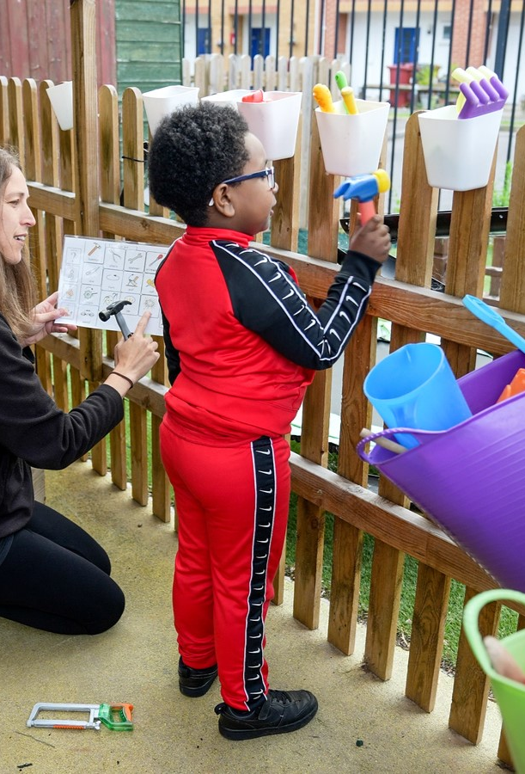
Dingley's Promise
Five Centres delivering tailored early intervention and family support
National training programme – movement for inclusion
Advisory support for 32 LA partners
Sponsor of APPG for Childcare and Early Education
Advisor for DfE Safety Valve Programme on EY SEND
The voice of children with SEND in the early years
Notes:
Key coalitions – EE&CC Coalition, SEC, DCP, Leeds Uni Business School EY Employment Group, NCFE training content advisors, Children's Alliance, EY SEND Partnership,

Slide 5
Why the lunch breaks?
DfE funded for 18 months
Early Years SEND Partnership
An opportunity to engage with more of you!
https://councilfordisabledchildren.org.uk/about-us-0/networks/early-years-send/eysend-partnership

Slide 6
Please tell us who you are in the chat and leave your email so we can stay in touch directly

Slide 7
Last time… Spotlight on exclusions Our paper (round up) to share what we talked about and the resources and ideas which were shared

Slide 8
Highlights
Tracking exclusions was mostly informal, however some are formally tracking
Most attendees were concerned about the norm of turning children with SEND away

Slide 9
Solutions?
Understand and find the funding
Use section 23 notifications
Have the conversation with the sector
Welcome conversations about exclusions
Use our table to develop a plan!

Slide 10
Spotlight session
Funding!

Slide 11
What are we allocated and why?
Base rate and supplements
Special Educational Needs Inclusion Fund (SENIF)
Disability Access Fund
High needs funding

Slide 12
SENIF and High Needs explained…
“Local authorities should target SENIFs at children with lower level or emerging SEN. Children with more complex needs and those in receipt of an education, health and care plan (EHC plan) continue to be eligible to receive funding via the high needs block of the DSG. Further information on the high needs funding system can be found in the high needs funding arrangements: 2023 to 2024. As with other elements of early years funding, SENIFs should apply to children attending settings in the relevant local authority area, regardless of where they live.”
“Local authorities should establish their SENIFs using funding from the early years block and/or the high needs block of their DSG allocation.”
https://www.gov.uk/government/publications/early-years-funding-2023-to-2024

Slide 13
DAF
“The funds could be used, for example, to support providers in making reasonable adjustments to their settings and/or helping with building capacity, be that for the child in question or for the benefit of children attending the setting.”
An example of how the funding is allocated by area was shared by Lincolnshire https://skillsfunding.service.gov.uk/view-latest-funding/dedicated-schools-grant/funding-breakdown/2024-to-2025/925/19-12-2023?searchTerm=Lincolnshire&tab=early-years

Slide 14
High Needs Block
“High needs funding supports provision for pupils and students with SEND who require additional resources to participate in education and learning, from their early years to age 25 in schools and colleges”
LAs must consult with the Schools Forum…
“However, to fulfil local authorities’ statutory duties to keep the services and provision for children and young people with SEND under review, as required by the Children and Families Act 2014, local engagement should take place with all of those providing education to ensure good quality provision can be planned, developed and sustained in line with available resources. This includes early years settings and colleges, as well as parents of children and young people with SEND, and young people themselves.”
https://www.gov.uk/government/publications/high-needs-funding-arrangements-2023-to-2024/high-needs-funding-2023-to-2024-operational-guide

Slide 15
Other funding sources and support?
Fees (are settings business planning for inclusion?)
Nursery Education Funding and supplements
Indirect support eg...
Higher rate Tax Free Childcare for working parents
Universal credit will help depending on income
Direct payments – or personal budgets
Parent can use DLA towards childcare
Right to request flexible working if a parent of a disabled child
https://www.childcarechoices.gov.uk

Slide 16
Don’t forget the related legislation
Childcare Act
https://www.legislation.gov.uk/ukpga/2006/21
Fiancial regulations
https://www.legislation.gov.uk/uksi/2023/59/contents/made
Child and Families Act
https://www.legislation.gov.uk/ukpga/2014/6/contents/enacted
Equalities Act
https://www.legislation.gov.uk/ukpga/2010/15/contents

Slide 17
So how do you make the case?
Evidence need locally and highlight national research
Highlight the risk of legal challenge
Engage senior leaders and members
Support your Schools Forum understanding of their role and totality of LA responsibilities
Ensure Early Years Inclusions is part of a strategic approach to wider LA priorities, safeguarding, attainment, SEND/Inclusion, regeneration and employment etc

Slide 18
Discussion time
What are you accessing?
What makes the difference?
What can you share?
How are supporting providers to maximise funds?
How are you supporting parents to maximise funds?

Slide 19
A reminder of how we can help and what else we are up to
Our research
Lobbying and our manifesto
Training and development
Planned support
Notes:
Our research – tell us what would help you – we can launch national research
Lobbying and manifesto – MPs and evidence for you to use
Training – FH area free of charge inclusion & transitions/ SPH free of charge/ or purchase directly
Other support – SV and DBV/ Hempsalls/ Dfe Assessment Toolkit/ CDC partnership/ more Centres

Slide 20
Ask the room

Slide 21
Spotlight next time? 4th March 12.30-1.30pm

Slide 22
What will you do next? And feedback in the chat please

Slide 23
Please tell us who you are in the chat and leave your email if we can stay in touch directly

Slide 24
Thank you for your continued commitment and passion!
Catherine Mcleod MBE catherine.mcleod@dingley.org.uk
Ann Van Dyke MBE ann.vandyke@dingley.org.uk
Tanya Flello tanya.flello@dingley.org.uk

