Slide 1
Welcome to our Inclusion Lunch Break!

Slide 2
Agenda
Introductions and welcome
You said we did (a round up from last time and what next)
A spotlight on exclusions in the Early Years
Ask the room
What next?

Slide 3
How shall we work today?
Cameras, mics, joining in and chat
We will make notes but not identify individuals
Can you give yourself this time?
Are you comfy?

Slide 4
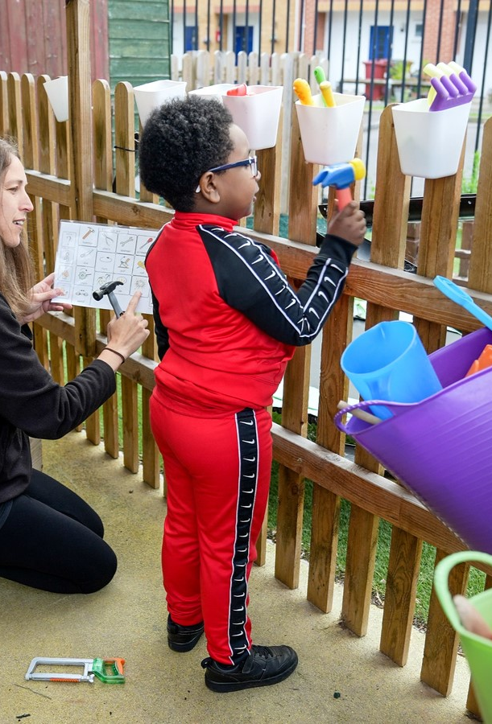
Dingley's Promise
Five Centres delivering tailored early intervention and family support
National training programme – movement for inclusion
Advisory support for 32 LA partners
Sponsor of APPG for Childcare and Early Education
Advisor for DfE Safety Valve Programme on EY SEND
The voice of children with SEND in the early years
Notes:
Key coalitions – EE&CC Coalition, SEC, DCP, Leeds Uni Business School EY Employment Group, NCFE training content advisors, Children's Alliance, EY SEND Partnership,

Slide 5
Why the lunch breaks?
DfE funded for 18 months
Early Years SEND Partnership
An opportunity to engage with more of you!
https://councilfordisabledchildren.org.uk/about-us-0/networks/early-years-send/eysend-partnership

Slide 6
Please tell us who you are in the chat and leave your email so we can stay in touch directly

Slide 7
Last time… Recording of our launch session Paper (round up) to share what we talked about and the resources and ideas which were shared

Slide 8
You said the challenges were…
Funding
The norm of turning children/families away
Schools requiring EHCPs
Recruitment and retention
Waiting lists
Reduced hours
LA capacity
Lack of specialist provision
Capacity and funding for sector
Sector at breaking point
Training and support for settings
Increasing numbers of children with SEND
When is a reasonable adjustment not a reasonable adjustment?
Red tape of referrals
SENIF being used for high needs not emerging needs
Schools expecting funding before accepting (or in some cases meeting) a child
The expansion of the entitlements will exasperate issues
School/EYs divide/relationships
Ratios impacting negatively

Slide 9
…and what we collectively did (and do)
Utilise the funding we have – EYIF, DAF, High Needs
Re-think the model – what we are trying to achieve and how we get there (eg from Herefordshire)
Rolling out OAP
Upskilling the workforce – training and development (with positive strategies to engage in training take up)

Slide 10
Spotlight session
Tackling exclusions in the Early Years

Slide 11
Some questions for consideration
How do we know it is an issue?
Who is measuring it and how?
What is the impact?
What are the things we can and can’t influence?
Funding?
Attitudes and culture?
Skills and knowledge?
Who do we need to influence and where does responsibility lie?
What drives change for those we need to influence?

Slide 12
Discussion - some considerations
Issues and potential solutions? | Who do we need to influence? | How?
Funding (and resources ie recruitment) More! Ringfenced Business planned for | Central Government Senior leaders and members School Forum Providers Families
Attitudes and culture
Skills and knowledge

Slide 13
A reminder of how we can help and what else we are up to
Our research
Lobbying and our manifesto
Training and development
Planned support
Notes:
Our research – tell us what would help you – we can launch national research
Lobbying and manifesto – MPs and evidence for you to use
Training – FH area free of charge inclusion & transitions/ SPH free of charge/ or purchase directly
Other support – SV and DBV/ Hempsalls/ Dfe Assessment Toolkit/ CDC partnership/ more Centres

Slide 14
Current situation
Only 15% of local authorities believe they have enough provision for children with SEND and 78% think the new entitlements will make it worse
95% settings say the number of children with SEND is rising - 79% say the rise is significant.
One in five parents have been turned away from settings.
27% of settings felt one year ago they had no more space for children with SEND – new entitlements rises to 57%.
Notes:
73% settings say number of children with SEND is rising / 28% of settings had turned children with SEND away/ 92% have had to use their own funds to support them. (Early Years Alliance 2022)/ 18% (Coram)
Capacity of settings to support children with SEND is reducing – recruitment and retention crisis means there aren’t enough staff to support inclusive practice, paperwork is significantly different for children with SEND (exacerbated by new EYFS) and settings don’t have the staff to spend time doing that paperwork, funding systems are complicated and have some major exclusions
Perfect storm of increased demand and reduced capacity to supply shown in the Coram stat of only 18% of local authorities believe they are sufficient for children with SEND in the early years. The University of East London found settings were increasingly turning away children with SEND, and the Early Years Alliance found 28% of settings had turned away children with SEND. This was before the changes.
Staffing crisis – EYPs leaving the sector due to lack of pay and recognition
Specialist staff shortage means delays to accessing specialist support – barrier to early intervention

Slide 15
Our Manifesto for Change
Funding that covers the cost of delivery
Recognition of the value of high quality early education rather than childcare
Recognition of the skills of the workforce
Sufficient places for all children – and especially children with SEND
Notes:
RISK: Real concern around increase in free entitlement and the impact it will have on provision for children with SEND. Increase in free entitlements historically has led to decrease in provision for children with SEND. 15 hours and 30 hours introduction saw increased demand for places, and widening of the gap between what children with SEND and their peers access. ‘Levelling the Playing Field’ shows that the impact of the introduction of the 2 year old offer was that local authority sufficiency for children with SEND actually fell from 28% to 21% in 2014-2015. Now at 18% - where will it be next?
RISK: more basic level, the funding for the ‘free’ entitlement is still not sufficient and so when the entire sector struggles financially, they are less likely to admit children with SEND who currently can cost the setting more in support costs, paperwork time and meeting time. Need to ensure supporting children with SEND doesn’t cost settings more than other children.
Ratio change – already struggling to provide high quality inclusive provision on current ratios.

Slide 16
Ask the room

Slide 17
Spotlight next time? 5th Feb 12.30-1.30pm

Slide 18
What will you do next? And feedback in the chat please

Slide 19
Please tell us who you are in the chat and leave your email if we can stay in touch directly

Slide 20
Thank you for your continued commitment and passion!
Catherine Mcleod MBE catherine.mcleod@dingley.org.uk
Ann Van Dyke MBE ann.vandyke@dingley.org.uk
Tanya Flello tanya.flello@dingley.org.uk

