Slide 1
Welcome to our Inclusion Lunch Break Launch!

Slide 2
Aim of today? To introduce ourselves, set the scene and we hope wet your appetite! Agenda
Who are we all?
Why the lunch breaks?
Our shared challenges
A spotlight on who we are and some of our successes
Opportunities and what works
Ask the room
What next?

Slide 3
How shall we work today?
Cameras, mics, joining in and chat
We will make notes but not identify individuals
Can you give yourself this time?
Are you comfy?

Slide 4
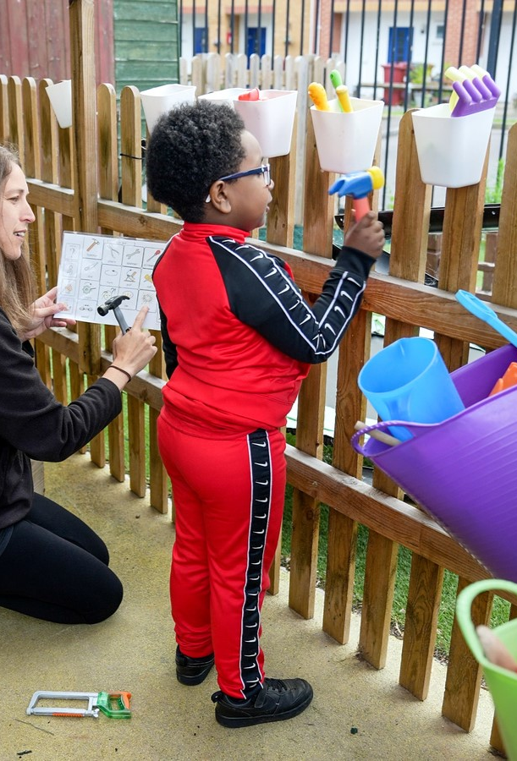
Dingley's Promise
Five Centres delivering tailored early intervention and family support
National training programme – movement for inclusion
Advisory support for 32 LA partners
Sponsor of APPG for Childcare and Early Education
Advisor for DfE Safety Valve Programme on EY SEND
The voice of children with SEND in the early years
Notes:
Key coalitions – EE&CC Coalition, SEC, DCP, Leeds Uni Business School EY Employment Group, NCFE training content advisors, Children's Alliance, EY SEND Partnership,

Slide 5
Please tell us who you are in the chat and leave your email so we can stay in touch directly

Slide 6
Why the lunch breaks?
DfE funded for 18 months
Early Years SEND Partnership
An opportunity to engage with more of you!
https://councilfordisabledchildren.org.uk/about-us-0/networks/early-years-send/eysend-partnership

Slide 7
What are we aiming to do with this work?
To support early years inclusion and the managing of good transitions to track and improve outcomes for children with SEND.
To drive improved outcomes at a strategic and operational level over the next 18 months.
To harness and continue to grow good practice and an evidence-based approach across all areas .
To share evidence and good practice regionally and nationally to reach more areas, practitioners, children, and families.

Slide 8
How? Specific work with a small number of LAs with Family Hubs (action learning sets and training offer) Monthly Inclusion Lunch Breaks Regional events National event

Slide 9
Challenges Naming the issues in the chat

Slide 10
What do we collectively know?
The childcare expansion will increase demand
Central resources are under pressure
Recruitment and retention is a challenge across all sectors
Each previous expansion has seen the take up gap widen for children with SEND
LAs carry legal duties (Childcare Act 2006 +16) to reduce inequalities and support families to work
EYs Outcomes
Sufficiency
Information
Notes:
a change to the current statutory minimum staff:child ratios in England for 2-year-olds from 1:4 to 1:5;
• clarifying that childminders can care for more than the currently-specified maximum of three young children, when caring for siblings of children they already care for, or when caring for their own child; and
• clarifying that “adequate supervision” while children are eating means that children must be within sight and hearing of an adult (rather than the current wording of “sight or hearing”).

Slide 11
Research tells us the impact on families is real Forgotten Families – Contact a Family Report 2011
72% experience mental ill health such as anxiety, depression or breakdown due to isolation
almost half (49%) have felt so unwell that they asked their GP for medication or have seen a counselor
57% say lack of support means they are isolated and not able to work as much as they would like
1 in 5 (21%) say that isolation has led to the break up of their family life.

Slide 12
What’s changed for families? Covid and confidence In work poverty Norms around balancing work and home Rising poverty, inequality and poverty Ref: The changing face of early childhood in the UK. The Nuffield Foundation July 22
Notes:
Covid and confidence
In work poverty
Norms around balancing work and home
Rising poverty, inequality and poverty

Slide 13
Current situation
Only 15% of local authorities believe they have enough provision for children with SEND and 78% think the new entitlements will make it worse
95% settings say the number of children with SEND is rising - 79% say the rise is significant.
One in five parents have been turned away from settings.
27% of settings felt one year ago they had no more space for children with SEND – new entitlements rises to 57%.
Notes:
73% settings say number of children with SEND is rising / 28% of settings had turned children with SEND away/ 92% have had to use their own funds to support them. (Early Years Alliance 2022)/ 18% (Coram)
Capacity of settings to support children with SEND is reducing – recruitment and retention crisis means there aren’t enough staff to support inclusive practice, paperwork is significantly different for children with SEND (exacerbated by new EYFS) and settings don’t have the staff to spend time doing that paperwork, funding systems are complicated and have some major exclusions
Perfect storm of increased demand and reduced capacity to supply shown in the Coram stat of only 18% of local authorities believe they are sufficient for children with SEND in the early years. The University of East London found settings were increasingly turning away children with SEND, and the Early Years Alliance found 28% of settings had turned away children with SEND. This was before the changes.
Staffing crisis – EYPs leaving the sector due to lack of pay and recognition
Specialist staff shortage means delays to accessing specialist support – barrier to early intervention

Slide 14
Opportunities, what are we doing and what could we do?

Slide 15
Our Manifesto for Change
Funding that covers the cost of delivery
Recognition of the value of high quality early education rather than childcare
Recognition of the skills of the workforce
Sufficient places for all children – and especially children with SEND
Notes:
RISK: Real concern around increase in free entitlement and the impact it will have on provision for children with SEND. Increase in free entitlements historically has led to decrease in provision for children with SEND. 15 hours and 30 hours introduction saw increased demand for places, and widening of the gap between what children with SEND and their peers access. ‘Levelling the Playing Field’ shows that the impact of the introduction of the 2 year old offer was that local authority sufficiency for children with SEND actually fell from 28% to 21% in 2014-2015. Now at 18% - where will it be next?
RISK: more basic level, the funding for the ‘free’ entitlement is still not sufficient and so when the entire sector struggles financially, they are less likely to admit children with SEND who currently can cost the setting more in support costs, paperwork time and meeting time. Need to ensure supporting children with SEND doesn’t cost settings more than other children.
Ratio change – already struggling to provide high quality inclusive provision on current ratios.

Slide 16
Some of our successes so far
Over 65% of children who start with our settings move into mainstream settings
11,000+ practitioners are taking up training and…
96% of practitioners who complete our Introduction course alone say they can take more children with SEND as a result.
Parent carer engagement can become parent led services
Measuring sufficiency evidences your impact and has reshaped and secured resource for change in some areas

Slide 17
…and in the pipe line
Notes:
More course including leadership and management
More centres
More influence
More training
Potential for more “what you can do” resources and support

Slide 18
How about you? What are you doing that makes a difference? What else can we do to help?

Slide 19
Ask the room

Slide 20
Spotlight next time? 8th Jan 12.30-1.30pm

Slide 21
What will you do next? And feedback in the chat please

Slide 22
Please tell us who you are in the chat and leave your email if we can stay in touch directly

Slide 23
Thank you for your continued commitment and passion!
Catherine Mcleod MBE catherine.mcleod@dingley.org.uk
Ann Van Dyke MBE ann.vandyke@dingley.org.uk
Tanya Flello tanya.flello@dingley.org.uk

