Slide 1
Securing Sufficiency for EYs Children with SEND

Slide 2
Our agenda today
Who we all are and where this work has come from
The legal framework
Market managing for inclusion – developing your action plan to secure sufficiency
Case study from Wiltshire
Next steps you could take
What are you doing now and what could you do next?

Slide 3
How shall we work?
Cameras, mics, joining in and chat
Can you stop the clock and give yourself this time?
Are you comfy?
Who are we all? Please tell us in the chat!

Slide 4
Who we are, and what we do
A charity delivering specialist nursery provision for children with SEND
Working with children, families and mainstream providers
Thousands of children and families supported over 40 years
35% to 70% transitions to the mainstream
A will to drive an inclusion movement
Working across the UK with LAs, providers, partners & parents
National training for inclusion
Lobbying for change nationally representing their voices
www.dingley.org.uk

Slide 5
A reminder about our previous papers and sessions
The benefits of early intervention, The Business Case for Assessing and Securing Sufficiency for Children with SEND
Measuring sufficiency for children with SEND

Slide 6
Naming our shared concerns
Pressure on the sector (rising costs and recruitment and retention issues)
Pressure on the public sector purse
The profile of early years locally and allocation of resources
Increased numbers of children with SEND
Are we in danger of widening the gap?
What else? (tell us in the chat)

Slide 7
Our own research shows…
95% settings say the number of children with SEND is rising - 79% say the rise is significant.​
One in five parents turned away
27% of settings felt one year ago they had no more space for children with SEND – new entitlements rises to 57%.​
Only 15% of local authorities believe they have enough provision for children with SEND and 78% think new entitlements will make it worse​.
Coram 2024 Childcare Annual Report shows only 6% of local authorities are sufficient

Slide 8
What do parents tell us?
““Trying to find childcare was horrific, I ended up seeing my doctor I was so worried about my child, having to give up work and money”
“My mental health was suffering anyway. I needed a break from 24/7 caring and I just kept being told there were no spaces or I had to go through yet another process when other families just got theirs”
“My child needs to socialise and have these experiences more than other children not less”
“It felt like me and my child were being rejected over and over”
“What happens to the parents who are not articulate and confident enough to complain?”.
Parent representatives on the Dingley’s Parent Board

Slide 9
The legal requirements
The Childcare Act 2006 and 16 sections 6, 7, 8 and 9 https://www.legislation.gov.uk/ukpga/2006/21/notes/division/6/1. require LAs to secure childcare for working parents and the early education entitlements, whilst also outlining the LA powers to do so. The duties specify that provision for children with SEND should be secured for children up to the age of 18.
Measuring Sufficiency for Children with SEND
Dingley’s Promise Feb 2024
Question - Are you taking reasonable steps to secure sufficiency or increasing the risk of legal challenge ?

Slide 10
What are our powers?
Securing early childhood services
Securing childcare sufficiency
Informing providers, partners and families
Direct delivery should be as a last resort (ie where market forces will not respond).
Do you sign post, develop, commission or deliver childcare services?

Slide 11
So how can you take “reasonable steps” and what are our levers for change?

Slide 12
1. Do you have a vision for your childcare market?
Quality
Accessible
Affordable
Diverse
Partnership
INCLUSIVE!
Can you know which road to take if you aren’t clear about where you are going?

Slide 13
2. Data driven change
Are you measuring sufficiency for children with SEND?
Are you using your data to drive change?
What is happening to supply and demand?
What do we know about turn over of the sector and providers types?
How are you communicating your data to the sector and to potential providers?

Slide 14
3. Using turn over to drive change
Publicise your CSA
Actively recruit new providers
Design start up support to encourage inclusive provision
Offer or sign post business support for inclusion
Identify inclusive buddies

Slide 15
4. And continue to drive new norms
Regularly share your CSA findings with providers
Normalise and welcome concerns
Share info about funding (from the LA, providers and families)
Celebrate your champions but avoid the honey pot effect
Support and challenge but don’t collude

Slide 16
5. Parental demand creating new norms
How do we know it works?
How can we use it?
Check lists and easy to find info
OAP widely shared
Showcasing what good looks like
Whistleblowing
Parent carer led activity

Slide 17
How do we support parent led activity?
From our experience;
Clarify the role (and rewards)
Recruit, but think big about how
Create a unit
Measure impact
Reward results
Think now and next

Slide 18
6. Increasing confidence and skills Why?
Because over 12000 practitioners are engaged in our training and of those who complete it 99% say they can take more children with SEND as a result.

Slide 19
What might help?
Look around for free training
Link to the DfE campaign
Create new norms in induction training for new staff
Develop and share reward systems
Celebrate your successes and champions
Let families know about it

Slide 20
7. Reducing paperwork
Have we widened the gap and created a disincentive?
A national recognition
Applications verses reporting

Slide 21
8. A word about carrots and sticks
Focusing on positive change and celebrating solutions
Where is the line between meeting individual needs and discrimination?
What do we do about it?

Slide 22
Case Study Wiltshire

Slide 23
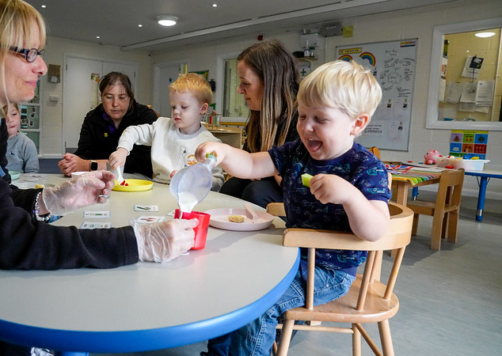
What can help you achieve sufficiency?
Ordinarily Available Provision document for early years
Parent power
HNB/ health/ underspend investment
Equality duty
Supporting the status of the early years
Incentivised training
Simple processes with minimal paperwork

Slide 24
Next steps you could take
Use all of our papers to support you
Do you have a lead who owns the work?
Develop an action plan
Who else is involved in influencing change in the market (eg quality)?
Use your data and share it widely
Manage the turnover of supply
Take account of supply and demand side activity
Review your training offers
Celebrate success and create new norms
Join our inclusion lunches

Slide 25
Questions?
What are you doing already?
What could you do?

Slide 26
Thank you for your passion and commitment!
ann.vandyke@dingley.org.uk
catherine.mcleod@dingley.org.uk

