Slide 1
Why securing sufficient early years and childcare places for children with SEND is crucial to council wide priorities
Catherine McLeod MBE catherine.mcleod@dingley.org.uk​ Ann Van Dyke MBE ann.vandyke@dingley.org.uk​
https://dingley.org.uk​

Slide 2
Welcome, introductions and housekeeping
Names
Role and LA area in the chat
Cameras and mics
Chat
Are you comfy?
Can you give yourself this time?

Slide 3
Aims and agenda
To equip you with knowledge, evidence and examples of how to secure council wide support for early years inclusion
Introductions and welcome
Why now more than ever?
The evidence base
Our inter related duties
The financial case for investment
Corporate and children’s services benefits
Case study from Gloucestershire
What can and will you do next?

Slide 4
Who we are, and what we do
A charity delivering specialist nursery provision for children with SEND
Working with children, families and mainstream providers
Thousands of children and families supported over 40 years
35% to 70% transitions to the mainstream
A will to drive an inclusion movement
A comprehensive and hugely successful training programme (96% of thousands tell us they can take more children with SEND)
Working across the UK with LAs, providers, partners & parents
Lobbying for change nationally representing their voices

Slide 5
Why now more than ever ?
Risks and opportunities from the childcare expansion

Slide 6
What are your concerns?
Notes:
Tell us in the chat what your concerns are about the expansion?

Slide 7
You recently told us the challenges were…
Funding
The norm of turning children/families away
Schools requiring EHCPs
Recruitment and retention
Waiting lists
Reduced hours
LA capacity
Lack of specialist provision
Capacity and funding for sector
Sector at breaking point
Training and support for settings
Increasing numbers of children with SEND
When is a reasonable adjustment not a reasonable adjustment?
Red tape of referrals
SENIF being used for high needs not emerging needs
Schools expecting funding before accepting (or in some cases meeting) a child
The expansion of the entitlements will exasperate issues
School/EYs divide/relationships
Ratios impacting negatively

Slide 8
What are the pressures?
Each expansion has reduced accessibility for children with SEND
The sector is already under strain
There is an increasing number of children with SEND
LA capacity is stretched
Funding is complicated
BUT confidence is a factor as well as funding

Slide 9
And opportunities?
Changes to demand and supply
Change = turn over in the sector
A wealth of experience
An acknowledgement centrally that this is an issue

Slide 10
The evidence base

Slide 11
What do we know from our work with you?
In some LAs there is a 200% increase in children with an ECP starting school
In some areas less than 50% of children with SEND access their full entitlements
There is a direct correlation between take up and disadvantage

Slide 12
Children with learning disabilities across childhood and adolescence are, compared to other children:
1.6 times more likely to be living in a family in income poverty
2.1 times more likely to have no adult in paid work in the household
1.4 times more likely to have a mother with mental health problems
3.3 times more likely to have a mother with poor physical health
1.5 times more likely to experience two or more negative life events such as bereavement and sexual abuse
1.5 times more likely to experience poor family functioning, for example, a decreased ability to problem solve or talk through problems as a family
1.3 times more likely to live in a single parent household
1.9 times more likely to have a primary carer with no educational qualifications
Investing in Early Intervention May 2022
https://cerebra.org.uk/wp-content/uploads/2022/05/EARLY-INTERVENTION-REPORT-A4-FINAL.pdf

Slide 14
What’s changed for families?
- Covid and confidence - In work poverty - Norms around balancing work and home - Rising poverty and inequality (widening the gap)
The changing face of early childhood in the UK
The Nuffield Foundation July 22
Notes:
Covid and confidence
In work poverty
Norms around balancing work and home
Rising poverty, inequality and poverty

Slide 15
Question
What other evidence can you link to your council priorities?

Slide 16
Our interrelated duties

Slide 17
Our Legal Requirements
The Childcare Act 2006 (16 and 18) enables a framework for delivery (and conversely, legal challenge) under three key areas:
• The early years outcomes duties requires the provision of early years services and joint working between agencies to reduce inequalities, improve outcomes and narrow the gap.
• The sufficiency duties require Local Authorities to ensure sufficient early education and childcare for the early years entitlements at two, three and four, and that they enable parents to take part in employment and employment-related activities (childcare for children aged 0-14, or 18 for children with a disability).
• The information duties require Local Authorities to ensure information for both childcare providers and families in order to meet the
other childcare duties.

Slide 18
Don’t forget the related legislation
Child and Families Act
https://www.legislation.gov.uk/ukpga/2014/6/contents/enacted
Equalities Act
https://www.legislation.gov.uk/ukpga/2010/15/contents
Fiancial regulations
https://www.legislation.gov.uk/uksi/2023/59/contents/made

Slide 19
The financial case for investment

Slide 20
The cost of not investing
Reduced income to the LA, sector and families
Legal challenge in the early years (and beyond)
Specialist verses mainstream = £52,500 per year per child

Slide 21
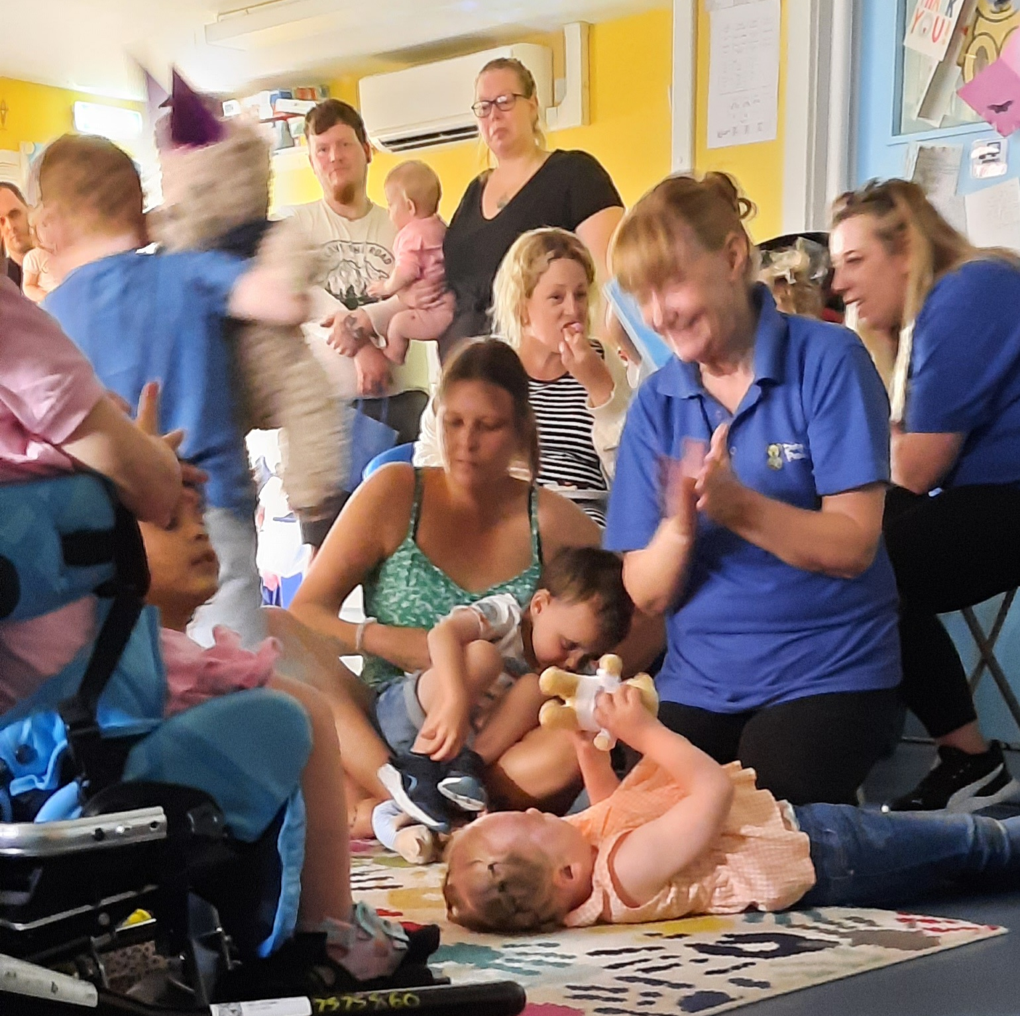
Case study: the cost benefits of early intervention
Local authority commissions early years assessment centre to support 25 children and families a year direct
Cohort unable to attend mainstream settings when they join
90% of children who leave go to the mainstream
Whole service annually cost local authority £180,000 (now £200,000)
Extra cost per annum to send a child to special school £52,540
For each year that each child helped early stays in mainstream their life outcomes are likely to be better and LA saves over £52,540

Slide 22
Corporate and children’s service benefits

Slide 23
For children's services
Safeguarding
Educational attainment
SEND support
Health and wellbeing
Family hubs

Slide 24
For the whole council and partners
Regeneration
Employment and housing
Capital strategies
Communications and public relations

Slide 25
Case Study - Gloucestershire

Slide 26
Questions?

Slide 27
Things we know that work to support investment
An overarching strategy linked to the legal framework
Member involvement
Data, data, data
A structure to reflect delivery
Articulate the funding
Identify your champions
Schools forum?
Publicity and marketing
Think about "the sell"

Slide 28
What can and will you do now and next?

Slide 29
Thank you for joining us and do keep in touch!
https://dingley.org.uk
Catherine McLeod MBE catherine.mcleod@dingley.org.uk Ann Van Dyke MBE ann.vandyke@dingley.org.uk

