Slide 1
Early Years Providers SEND National Research
September 2023

Slide 2
In September 2023 we conducted a national survey to help us better understand the situation for children with SEND from the early years’ settings perspective. Here is what our survey told us:

Slide 3
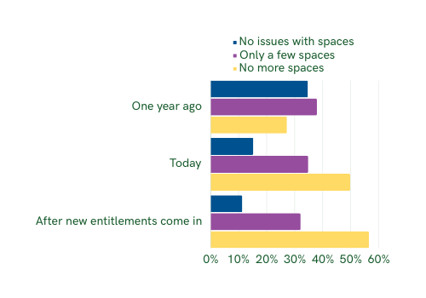
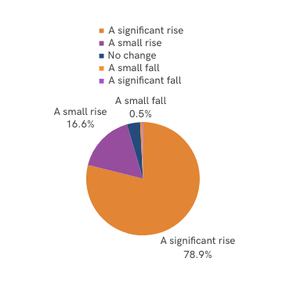
Have you seen a change in the
number of children with SEND?
Do you have spaces available for
new children with SEND?
Almost 80% of settings have seen a significant rise in the numbers of children with SEND
Currently only 50% of settings believe they have no more spaces for new children with SEND
When the new entitlements come in, 57% expected to have no more spaces for new children with SEND

Slide 4
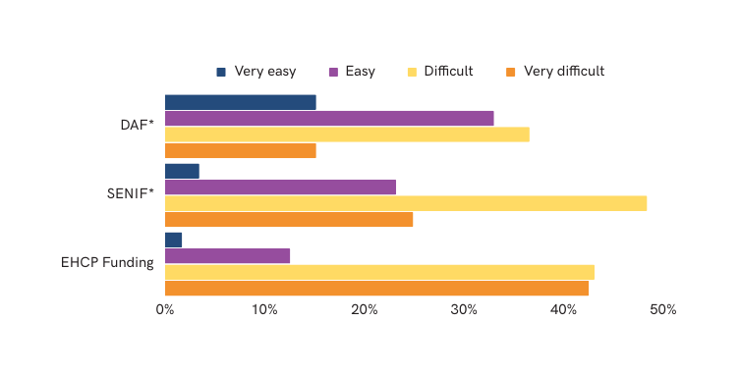
How easy is it to access SEND funding streams?
From our research findings:
Over 50% of settings find it difficult or very difficult to
access DAF funding
Over 70% of settings find it difficult or very difficult to
access SENIF funding
Over 80% of settings find it difficult or very difficult to
access EHCP funding
Key
DAF = Disability Access Fund, SENIF = Special Educational Need Inclusion Fund
The majority of settings report finding the current funding streams difficult or very difficult to access, particularly SENIF and EHCP Funding. This is creating a real barrier to inclusion as settings are not able to get the right funding at the right time.
The main barriers reported to funding are insufficient funding, volume of paperwork, and the lengthy time taken to access the funding.

Slide 5
Insufficient funds are draining provider’s finances

Slide 6
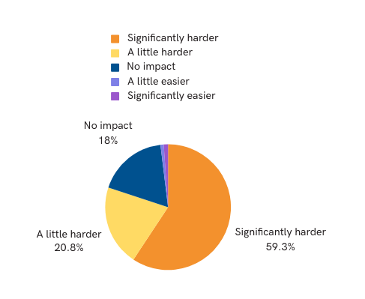
Over 80% of providers stated that the changes to ratios will result in it being increasingly difficult to support children with SEND.

Slide 7
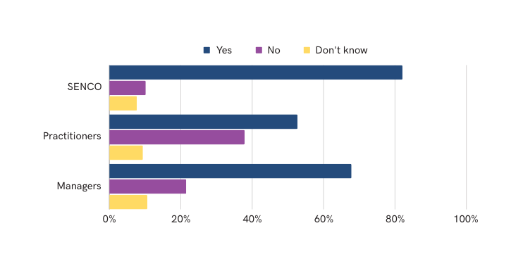
Providers stated that training is key to being inclusive and that the need for this training has increased in recent years.
The responses states recruitment and retention of staff with strong SEND knowledge is a significant barrier to effective SEND inclusion in their setting.
Our results show that whilst SENCO and Managers in settings
often have access to SEND training, this is not always available to the wider staff team. We know that this has a huge impact on being able to be a fully inclusive setting.

Slide 8
90% of settings state that the need for SEND inclusion training has increased in recent years.
Only 5% of settings state that recruitment and retention of staff with strong SEND knowledge is easy. Suggesting this is a significant barrier to effective SEND inclusion in their setting.
Over 40% of all settings asked said that funding for the resources, staffing and training being the most important factor in being able to provide the best provision for children with SEND in the early years.

Slide 9
Dingley’s Promise is lobbying MP’s and decision makers, along with our National SEND and early years partners for the following changes…
Our Manifesto recommendations to help settings:
Better access to funding for settings
Simpler application processes and quicker funding application processes.
De-linking of DAF and DLA to make access for settings more quickly and easily
Greater support from local authorities to ensure that where children with SEND require support settings can access the funds and resources required to support them.
More readily available Inclusive Training for early years settings to better support children with SEND.
www.dingley.org.uk/training
Because EVERY child has the right to the best early years education to give them the best start.

Slide 10
Share your voice and help us to amplify the voices of settings and the barriers they face and help us to make positive change in the early years a reality.
Visit www.dingley.org.uk/manifesto/ to download your letter of support and lobby your local MP for these vital changes.
Together we can build a more inclusive early years sector!

