Slide 1
Early Years Local Authorities SEND National Research
September 2023

Slide 2
In September 2023 we conducted a national survey to help us better understand the situation for children with SEND from the local authority’s perspective. Here are our findings:

Slide 3
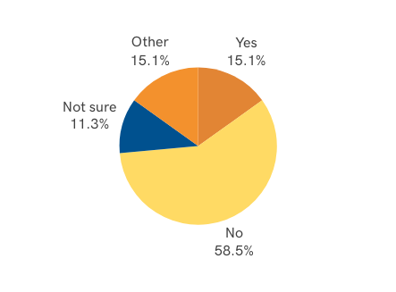

Slide 4
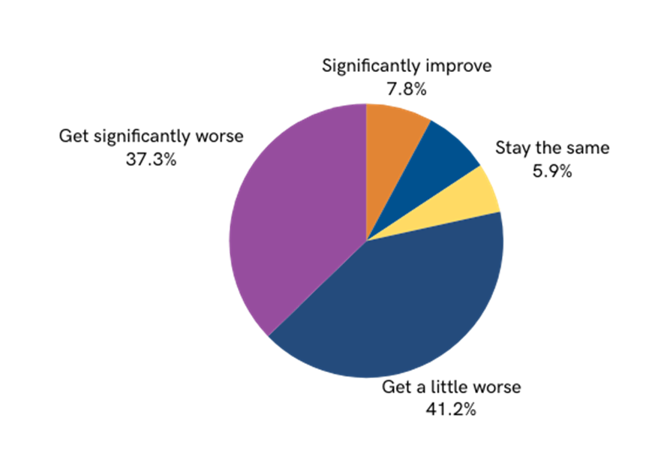
When local authorities were asked whether the new entitlements would have a negative effect on sufficiency for children with SEND in the early years, 78% stated that it would.
37% said it would make things significantly worse
41% said it would make things a little worse
Improve a little
7.8%

Slide 5
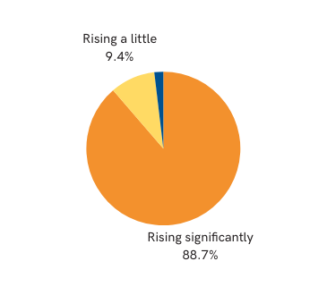
When asked what the take up of your early years funding streams is like…
50% stated that DAF funding was significantly or a little underspent
Staying steady
1.9%
87% stated that EHCP requests were rising significantly

Slide 6
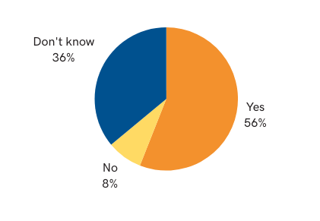
Only 56% of local authorities stated that the Child Sufficiency Assessment analysed supply and demand for children with SEND in the early years.

Slide 7
We asked local authorities what they thought needed to change to give children with SEND and their families the best provision and support in the early years.

Slide 8
We asked local authorities what they thought needed to change to give children with SEND and their families the best provision and support in the early years.

Slide 9
Dingley’s Promise is lobbying MP’s and decision makers, along with our National SEND and early years partners for the following changes…
Our Manifesto recommendations to help local authorities
Better access to funding for parents and settings
Simpler application processes and support to enable settings to complete them and get support in a timely way
De-linking of DAF and DLA to make access for families and settings quicker and easier
Greater clarity on sufficiency from settings so that the right support can be given to ensure children aren’t turned away.
Training for early years specialist to enable them to support settings to be more inclusive
Because EVERY child has the right to the best early years education to give them the best start.

