Slide 1
Early Years Families SEND National Research
September 2023

Slide 2
In September 2023 we conducted a national survey to help us better understand the situation for children with SEND from the family’s perspective. What our survey told us:

Slide 3
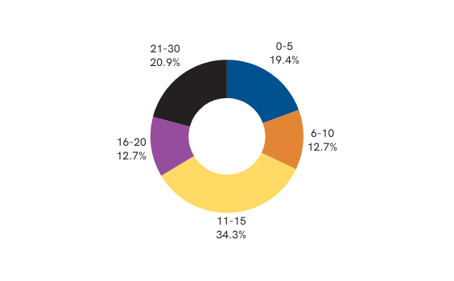
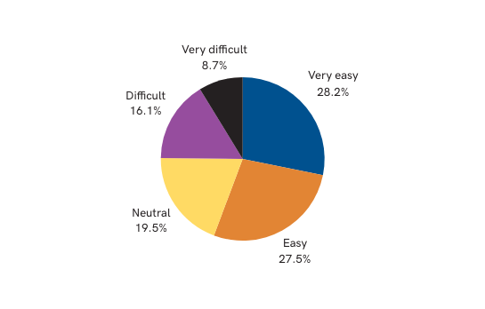
Q: How many hours does your child access?
Q: How easy was it to get a space at the early years setting?
Just under a quarter of parents found it difficult or very difficult to
secure a place for their child.
18% reported having been ‘turned away’ from a setting.

Slide 4
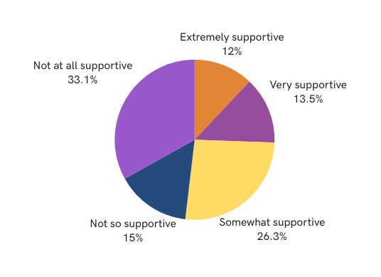
Q: How supportive were your local authority in helping you secure a place?
Worryingly 33.1% of parents stated that
they felt totally unsupported by the local authority

Slide 5
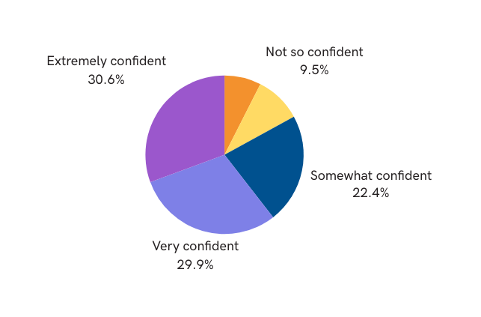
Q: How confident are you that the early years setting is meeting your child’s needs?
Not at all confident
7.48%
The majority of families reported that they have a level of trust in their child’s setting, but some remain concerned that they are
fully meeting their child’s needs

Slide 6
This is how families describe their experience of getting the right support for their child….

Slide 7
We asked families how they think the early years could be improved for
children with SEND and their families…

Slide 8
Dingley’s Promise is lobbying MP’s and decision makers, along with our National SEND and early years partners for the following changes…
Our Manifesto recommendations to help families:
Better access to funding for parents
Simpler application processes and support to complete them
De-linking of DAF and DLA to make access for families quicker and easier
Greater clarity on sufficiency from local authorities and support for settings who do not feel they can support children with SEND
Training for early years settings to support them to be more inclusive
Because EVERY child has the right to the best early years education to give them the best start.

Slide 9
Share your voice and help us to amplify the voices of families, the barriers they face and help us to make positive change in the early years a reality.
Visit www.dingley.org.uk/manifesto/ to download your letter of support and lobby your local MP for these vital changes.
Together we can build a more inclusive early years sector!

