Slide 1


Comic Relief Early Years Inclusion Project Briefing Session Creating and inclusion movement!

Slide 2
Welcome, aims and housekeeping
Introductions, welcome and housekeeping
A walk through the project and discussion around how we collectively make it work
Next steps and feedback in the chat
Introduction to Dingley’s Promise and our role
The Parent/Carer role

Slide 3

Introductions and housekeeping
Who are you?
Cameras and mics
Chat
Confidentiality and respect
Ask if you are not sure about something
Can you give yourself this time?
Are you comfy?
Emails in the chat if we don’t have them already

Slide 4
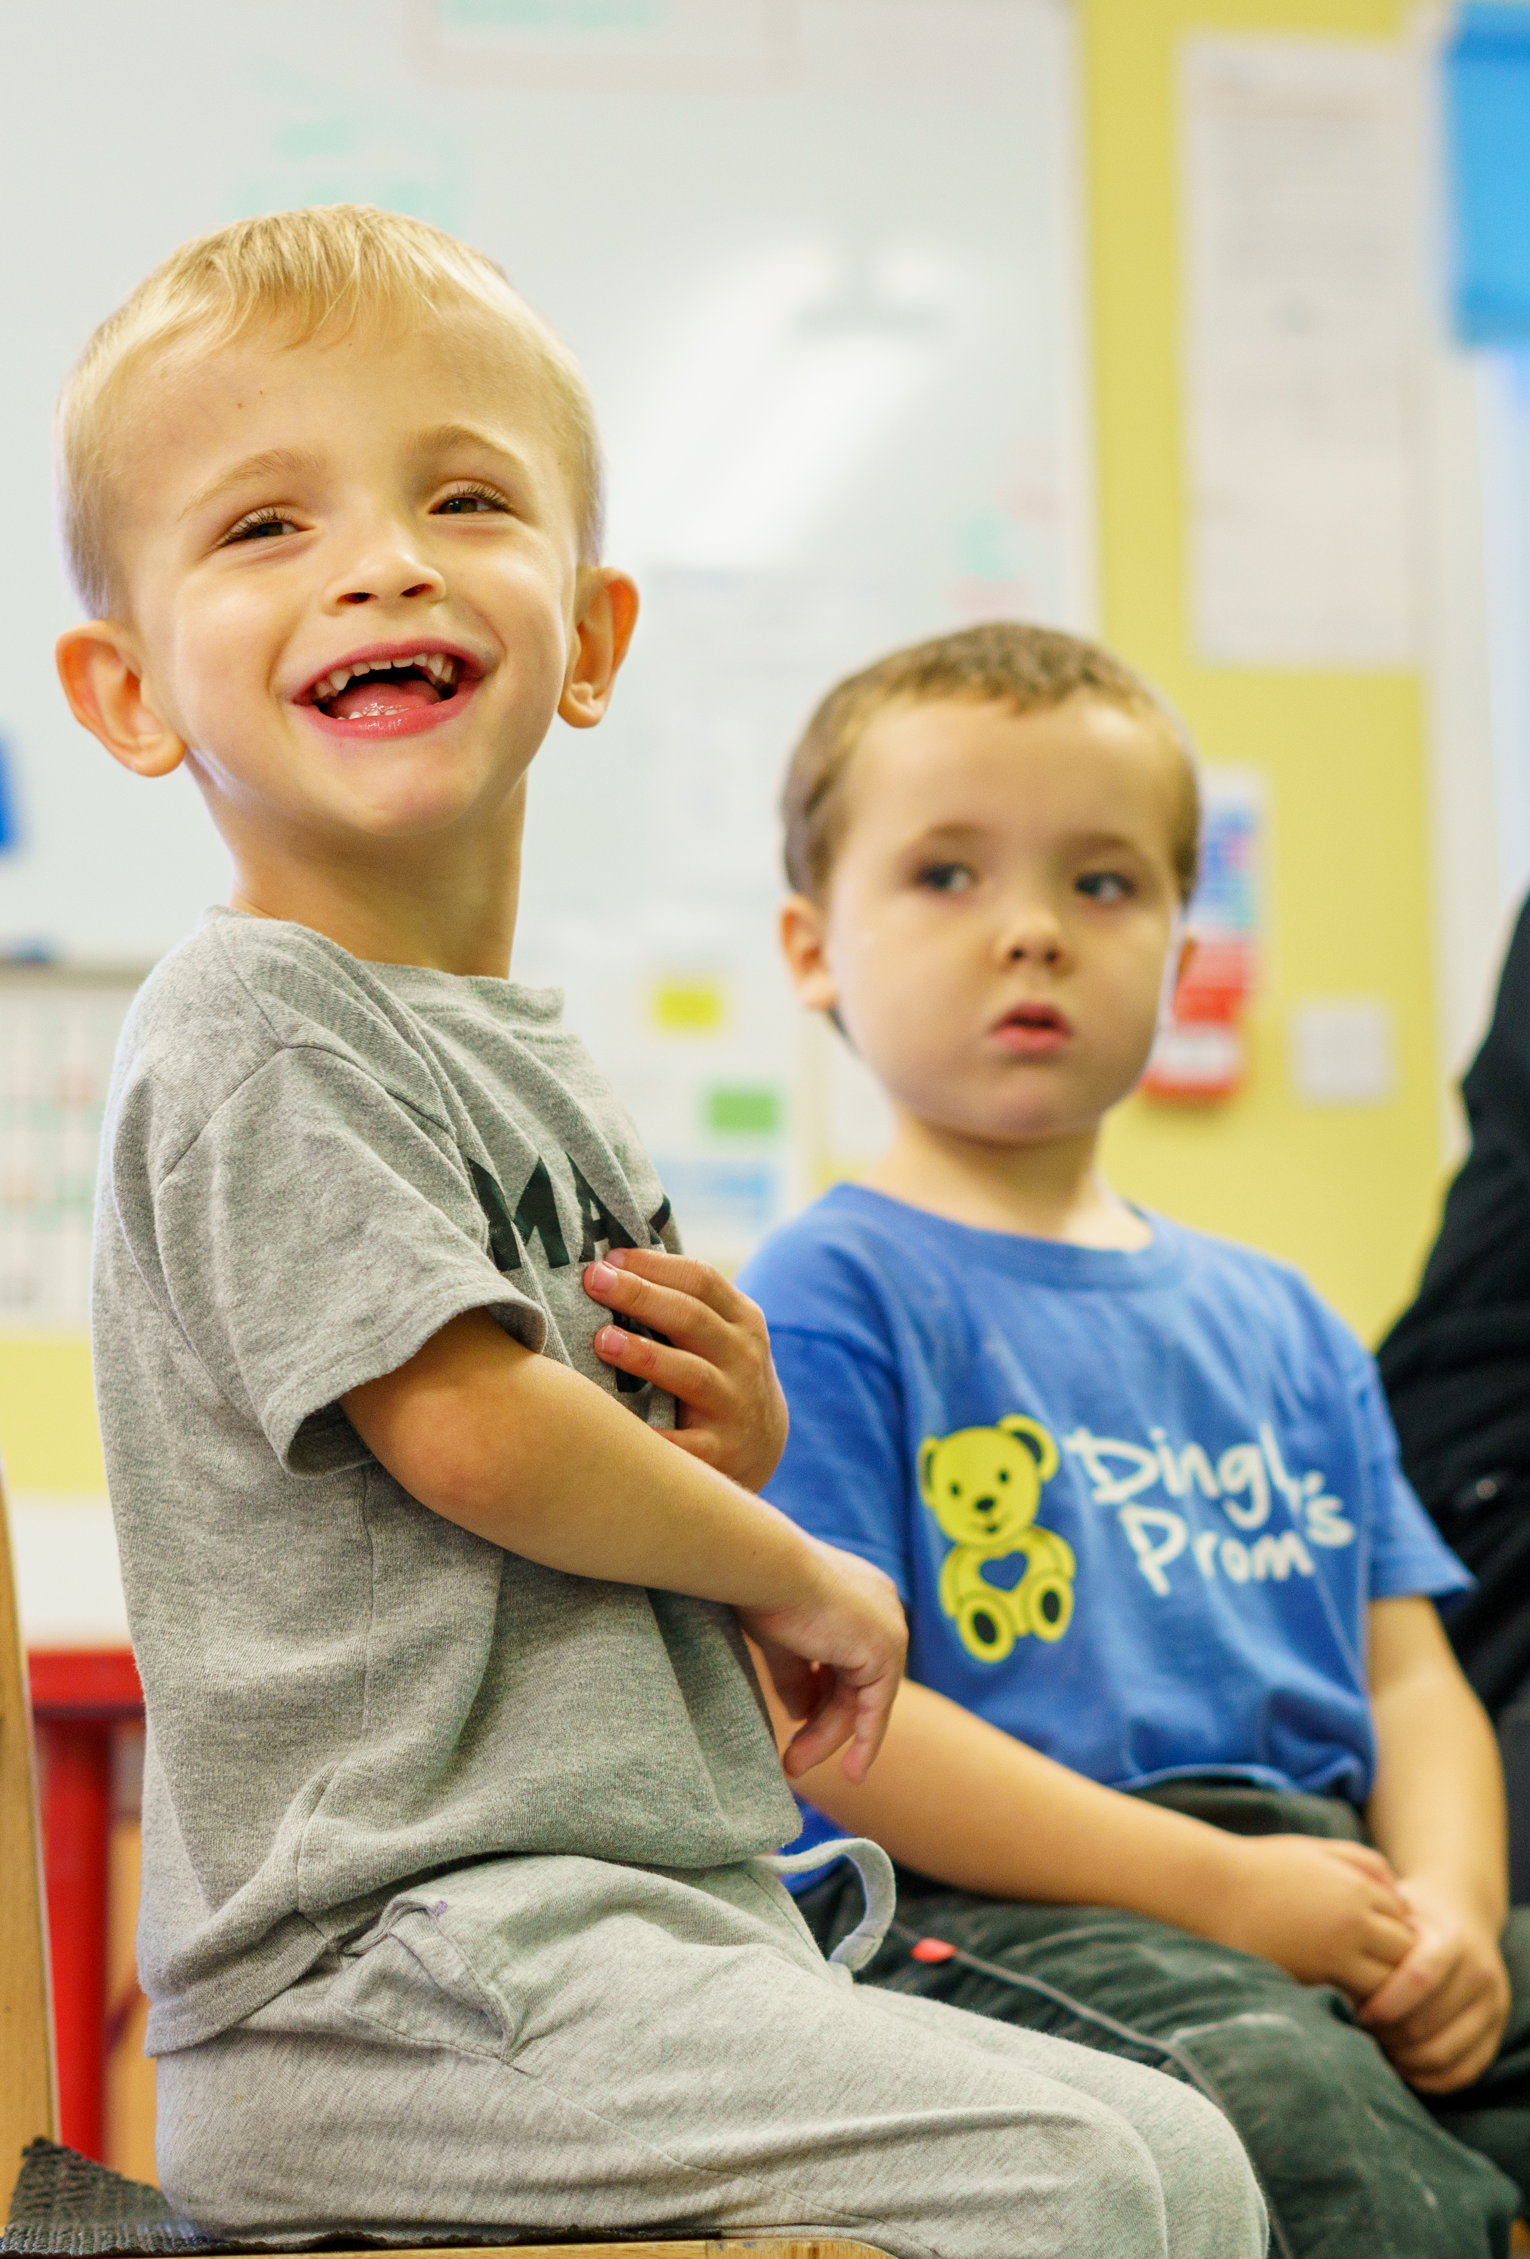
Who are Dingley’s Promise?
- Established 1983 by parents of children with SEND in Reading
- Six specialist early years settings delivering learning through play
- Family support & outreach programme
- Reach around 500 families directly annually
- National training and influencing to build wider inclusion

Slide 5
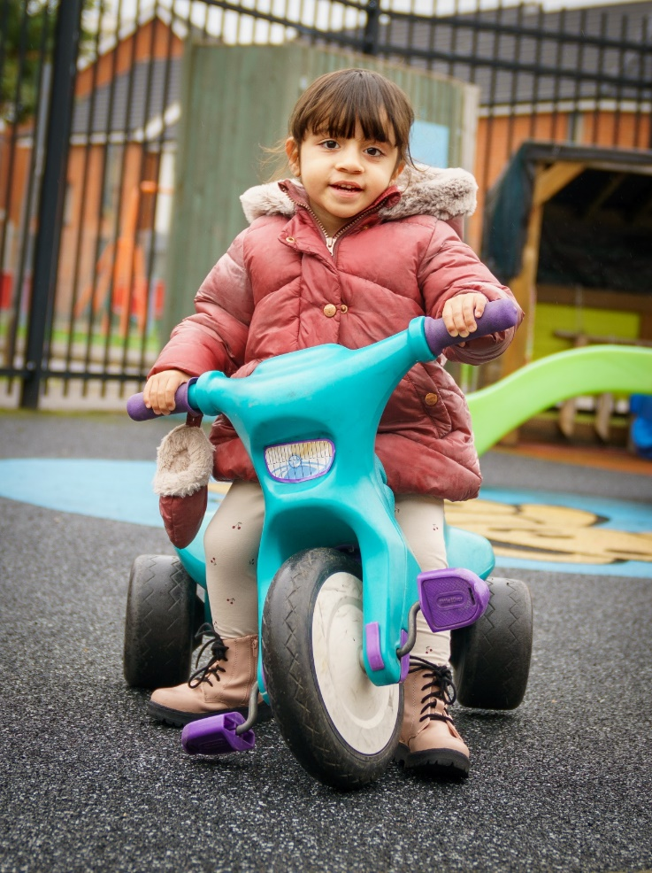
Training & Consultancy
- Level 3 Certificate in EY Inclusive Practice
- Lockdown & EY SEND Partnership
- Changemakers 5 year project
- Wider influencing
- National EY Specialist Providers Forum
- Creating guidance – EEP, Data driven approach, new EYFS for children with SEND
Notes:
In January 2018 launched Level 3 in EY Inclusive Practice with ncfe
Lockdown – inclusion training 737 across UK – invited to join partnership
EY SEND is what we live and breathe – often SEND without EY or EY without SEND – we bring together
We deliver at our three Centres so training grounded in experience
All Party Parliamentary Group – represent SEND
DCP – represent the early years
Support for LAs and other organisations to promote inclusion in the early years

Slide 6
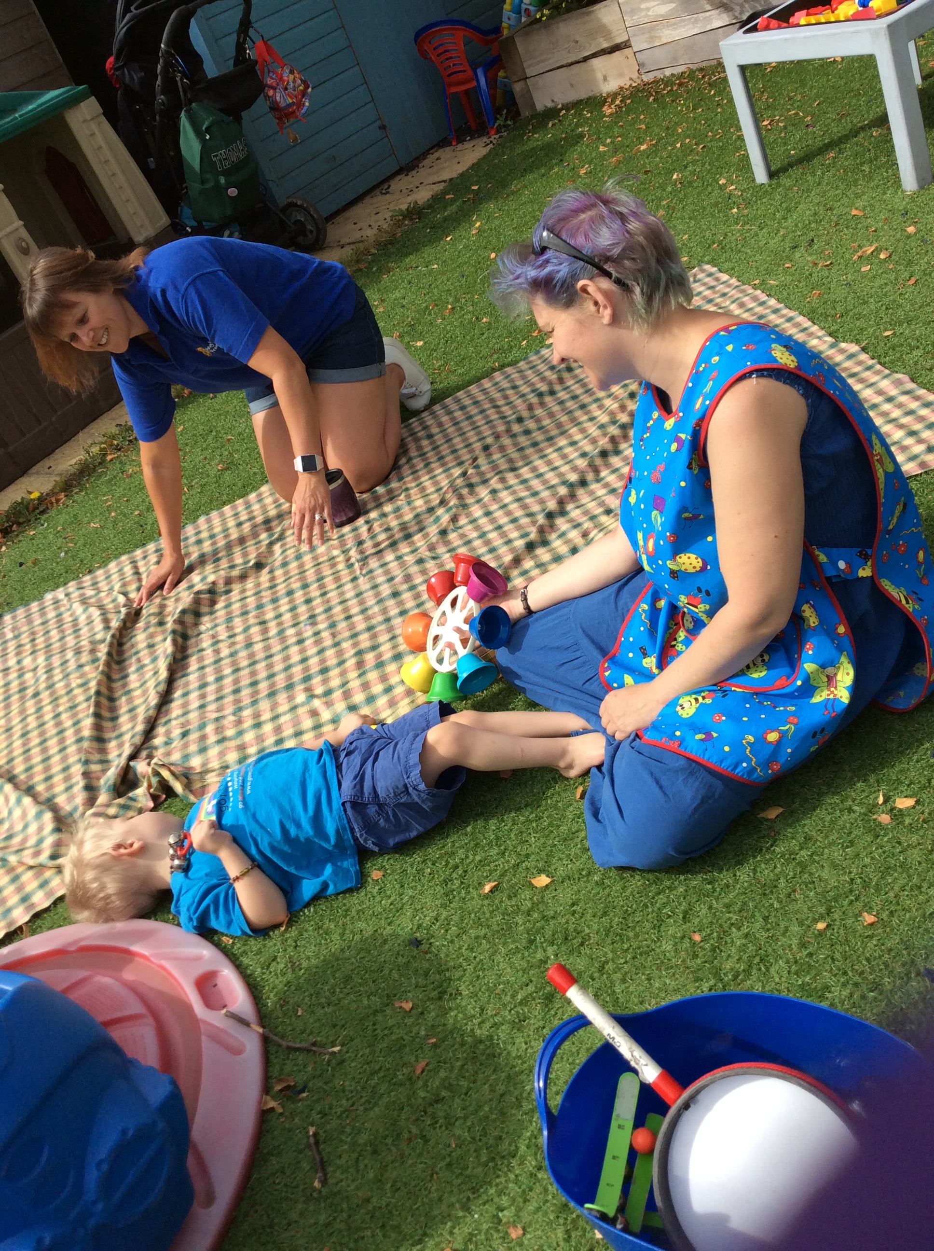
Why the Comic Relief bid?
Children with SEND are not taking up early years and childcare entitlements to the same extent as their peers
There is a shortage of inclusive places
Research shows training and confidence are critical barriers
We want to make a difference!

Slide 7
What do families tell us?
“Trying to find childcare was horrific, I ended up seeing my doctor I was so worried about my child, having to give up work and money”
“My mental health was suffering anyway. I needed a break from 24/7 caring and I just kept being told there were no spaces or I had to go through yet another process when other families just got theirs”
“Work was an outlet for me as well as an income source but I had to move my work to weekends which means I cram 20 hrs work into 2 days and have no time as a family”
Parent representatives on the Dingley’s Parent Board

Slide 8

Tell us your experiences in the chat ?

Slide 9

The aim of the project is… …to increase the number of young children with SEND accessing early years and childcare places through...
A Comprehensive and extensive training offer
Partnership with Local Authorities
A National Steering Group
Meaningful Parental Engagement
Notes:
-

Slide 10

Skilling up the workforce through a comprehensive and extensive training offer
Online training for the whole early year's workforce
10 courses which are:
- online
- flexible
- support individuals and can be completed as a team
- aimed at supporting confidence, skills and
practical ideas

Slide 11

Where are we now with training roll out?
Online training for the whole early year's workforce
10 courses in total with 5 courses out now:
Introduction To Early Years Inclusive Practice
Early Years SEND Transitions
Managing Behaviours that Challenge
Having Difficult Conversations with Families
Voice of the child
Coming soon in 2023
Anti-racism practice in Early Years
Further 4 courses to be developed according to need.

Slide 12

Results?
Over 7000+ practitioners engaged with the training so far!
Of those who have completed the training so far …
98% would recommend our learning to others.
100% feel more confident as a result of the training.
79% are committed to making a change in their setting as a result of the training.
91% of learners believe they can support more children with SEND as a result of the training.
NB – All data is based on those who completed the survey.

Slide 13

But… …our workforce are already overwhelmed!

Slide 14

So what works in supporting training take up?
Our regular top tips from our existing partners…
Regular coms
Face to face (and systems to prompt you)
Events and conferences
Book ends and wall paper!
Celebrate your champions but…
…Avoiding the honey pot effect
Reward systems – our kite mark
Parent power
Use our tools and resources eg social media pack, top tips, planner etc
Celebrate success and create new norms
Above all, keep it positive!

Slide 15

Meaningful parent/carer engagement

Slide 16

The role of the parent/carer
- Acting as your local area parent representative in a local stakeholder group which will meet twice in year one, and annually in subsequent years.
- Collaboration with other parent/carer representatives across the country through participation in a Parent Board which will meet quarterly.
- Representing the views of parents and carers on our national steering group which will meet twice a year.
- Acting as an advocate for the project
- Spreading the word !

Slide 17

What we will do to support you
Induction to support confidence and skills
4 x parent board meetings per year where honest feedback can be shared and agreed messages and actions taken forward
Representation in the overarching national project steering group
Continued peer support in being a parent rep throughout
Skilled and sensitive facilitation of all meetings to support participation
Regular communication throughout the programme
A highly skilled, experienced, knowledgeable and passionate team working with you throughout!

Slide 18


…What we will do to support you
- Act as your advocate to link you to the work in your area
- Representation at a national and international level in feeding back key learning and your challenges to decision makers whenever the opportunity arises.
- Deliver a project which listens and will adapt as we inevitably learn more about you, your area, and what makes a difference to children and families.
- Offer a kite mark for our parent/carer champions ?

Slide 19

What’s in it for you?
Being part of positive change
Feeling heard
Making connections, friendship and peer support
Acting as an advocate locally
Creating opportunities for other parent/carers locally
A great opportunity for professional development in being part of an international project!
Being part of an inclusion movement!

Slide 20

What’s in it for us?
Keeping us real!
Increased awareness of the project
Increased awareness and take up of the training
Demand led change across the whole area
Parent/carer experts to advise us throughout
A lasting legacy
A great team of parent/carers to work (and have fun) with!

Slide 21

What have our parent/carer reps been up to so far?
Spreading the word to other families locally
Joining in the LA planning meetings
Using social media
Attending parent and practitioners events and groups
Attending events and networks to represent the experiences of parent/carers
Mystery shopping
Creating leaflets, Q and A sheets and other coms
Speaking at local and our national events
Acting as a buddy for other new parent/carer reps

Slide 22


…What we ask
That you are a parent/carer or grandparent of a child with SEND and you have just enough;
- Time
- Confidence
- Respect
Commitment
- A positive can do attitude!

Slide 23

Questions and discussion How else can we help?

