Slide 1


Dingley’s Promise
Comic Relief Early Years Inclusion Project
Briefing Session

Slide 2

Who are Dingley’s Promise?
- Established 1983 by parents of children with SEND in Reading
- Five specialist early years settings delivering learning through play
- Family support & outreach programme
- Reach around 500 families directly annually
- National training and influencing to build wider inclusion

Slide 3
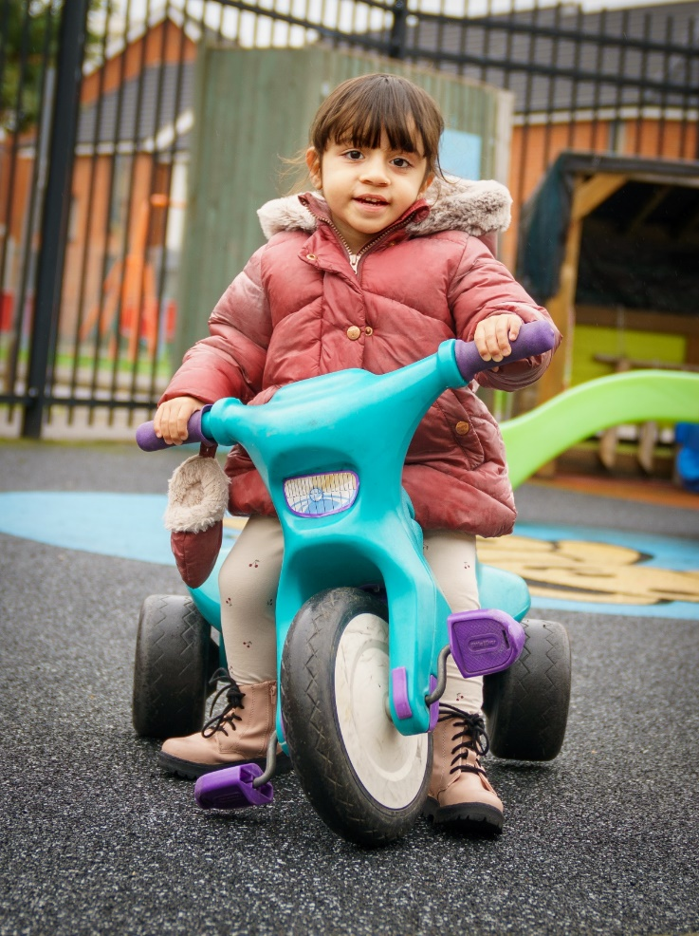
Training & Consultancy
- Level 3 Certificate in EY Inclusive Practice
- Lockdown & EY SEND Partnership
- Changemakers 5 year project
- Wider influencing
- National EY Specialist Providers Forum
- Creating guidance – EEP, Data driven approach, new EYFS for children with SEND
Notes:
In January 2018 launched Level 3 in EY Inclusive Practice with ncfe
Lockdown – inclusion training 737 across UK – invited to join partnership
EY SEND is what we live and breathe – often SEND without EY or EY without SEND – we bring together
We deliver at our three Centres so training grounded in experience
All Party Parliamentary Group – represent SEND
DCP – represent the early years
Support for LAs and other organisations to promote inclusion in the early years

Slide 4
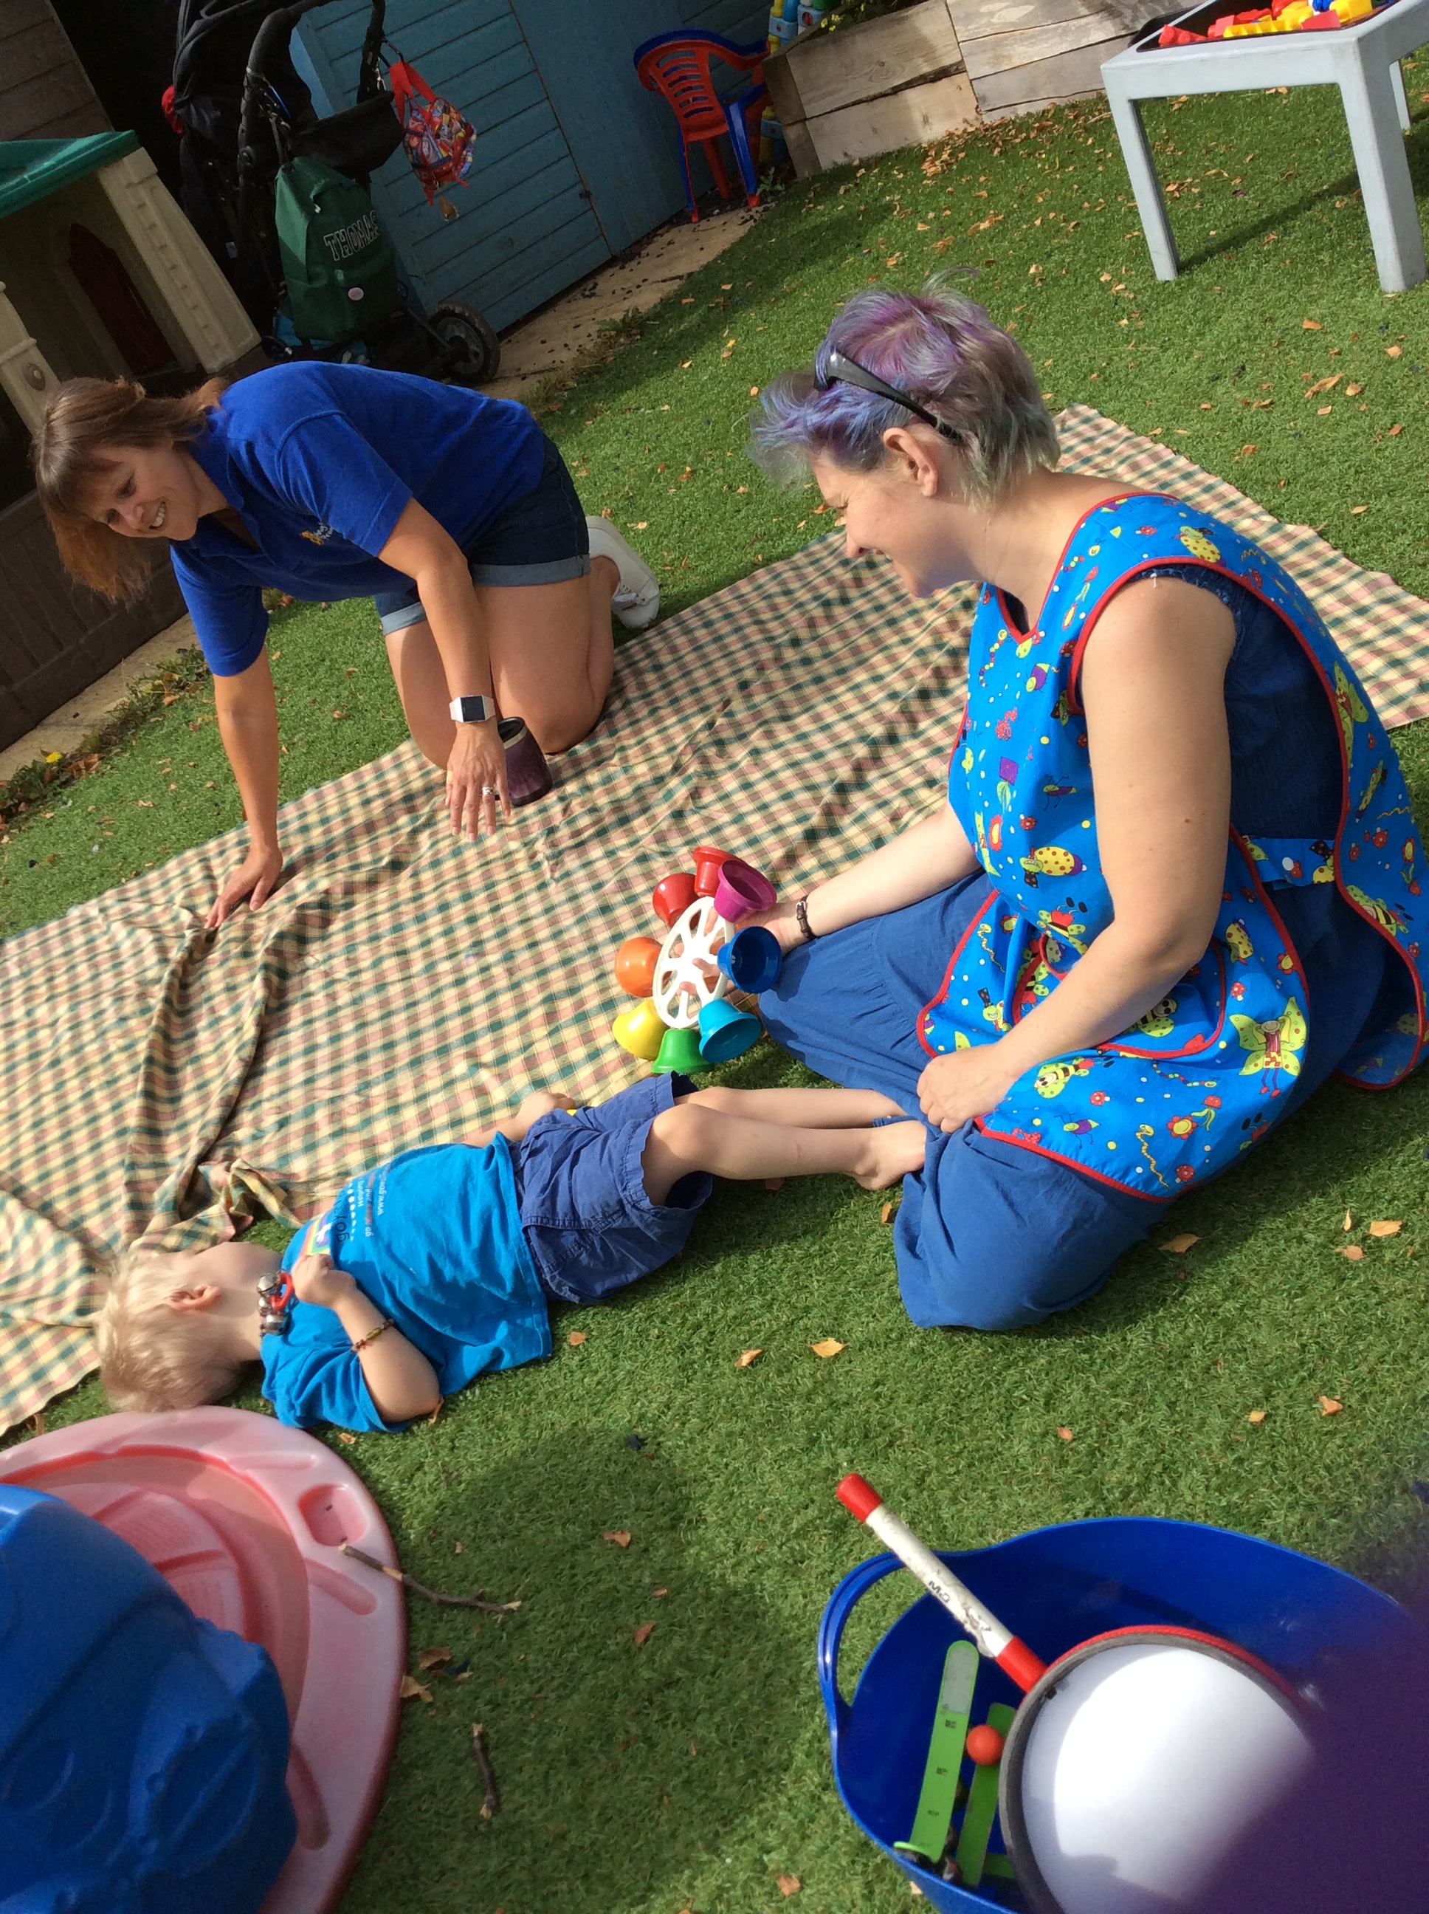
Why the Comic Relief bid?
Children with SEND are not taking up early years and childcare entitlements to the same extent as their peers
There is a shortage of inclusive places
Research shows training and confidence are critical barriers
We want to make a difference!

Slide 5
What do families tell us?
“Trying to find childcare was horrific, I ended up seeing my doctor I was so worried about my child, having to give up work and money”
“My mental health was suffering anyway. I needed a break from 24/7 caring and I just kept being told there were no spaces or I had to go through yet another process when other families just got theirs”
“Work was an outlet for me as well as an income source but I had to move my work to weekends which means I cram 20 hrs work into 2 days and have no time as a family”
Parent representatives on the Dingley’s Parent Board

Slide 6

The aim of the project is…
…to increase the number of young children with SEND accessing early years and childcare places through...
Partnership with Local Authorities
Meaningful Parental Engagement
A National Steering Group
A Comprehensive and extensive training offer
Notes:
-

Slide 7

Skilling up the workforce through a comprehensive and extensive training offer
Online training for the whole early year's workforce (aiming to reach 30,000 practitioners)
10 courses which are:
- online
- flexible
- support individuals and can be completed as a team
- aimed at supporting confidence, skills and
practical ideas

Slide 8

Where are we now with training roll out?
Online training for the whole early year's workforce
10 courses in total with 5 courses out now:
  Introduction To Early Years Inclusive Practice
  Early Years SEND Transitions
  Managing Behaviours that Challenge
  Having Difficult Conversations with Families
  Voice of the child
Coming soon in 2023
  Anti-racism practice in Early Years
Further 4 courses to be developed according to need.

Slide 9

Results?
Over 6000 practitioners engaged with the training so far!
Of those who have completed the training so far …
99% would recommend our training to others.
91% feel more confident as a result of the training.
81% are committed to making a change in their setting as a result of the training.
96% of learners believe they can support more children with SEND as a result of the training.

Slide 10

But…
…our workforce are already overwhelmed!

Slide 11

So what works in supporting training take up?
  Our regular top tips from our existing partners…
  Regular coms
  Face to face (and systems to prompt you)
  Events and conferences
  Book ends and wall paper!
  Celebrate your champions but…
  …Avoiding the honey pot effect
  Reward systems – our kite mark
  Parent power
  Use our tools and resources eg social media pack, top tips, planner etc
  Celebrate success and create new norms
  Above all, keep it positive!

Slide 12
What’s in it for your area?
A chance to do the right thing and address a significant inequality
Legal compliance in securing sufficient early years and childcare places for children with SEND, both measuring it and taking reasonable steps
Approximately £.5 million workforce investment in your area
Supporting more families to access universally inclusive place (helping meet increased demand for support)
Parent/carer representation in the early years
Potential spin offs?
  Parent led services?
  Improved delivery for over 5s out of school too?

Slide 13

Questions and ideas are always welcome!
Catherine McLeod MBE catherine.mcleod@dingley.org.uk
Ann VAN DYKE MBE ANN.VANDYKE@DINGLEY.ORG.UK
AMANDA BROWN AMANDA.BROWN@DINGLEY.ORG.UK
Notes:
Always gathering resources and information – get in touch if you want anything shared with you, to discuss anything or want access to training.

