Slide 1


Early Years Inclusion Training Programme Overview

Slide 2
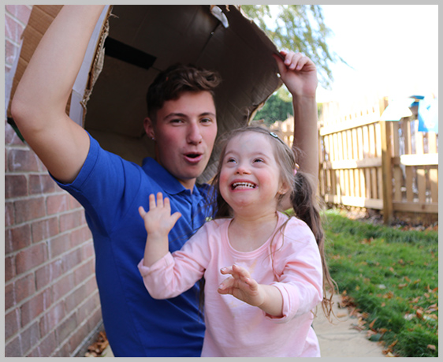
Welcome
Housekeeping
Recording
Mute
Questions
Slides
Introduction to your hosts
Amanda Brown – Training Programme Manager
Catherine McLeod MBE – Chief Executive
Notes:
AMANDA

Slide 3
What we’ll cover
Who are Dingley’s Promise?
What can we offer you and how will it help you and your setting?
Q & A
What is the Early Years Inclusion project?
What are our learners saying?
What else do you need to know?
Notes:
AMANDA

Slide 4

Who are Dingley’s Promise?
Established 1983 by parents of children with SEND
Three specialist early years settings – tailored LTP
Family support & outreach programme
National training programme
Level 3 Certificate in EY Inclusive Practice
Lockdown & EY SEND Partnership
National influencing
Notes:
CATH

Slide 5
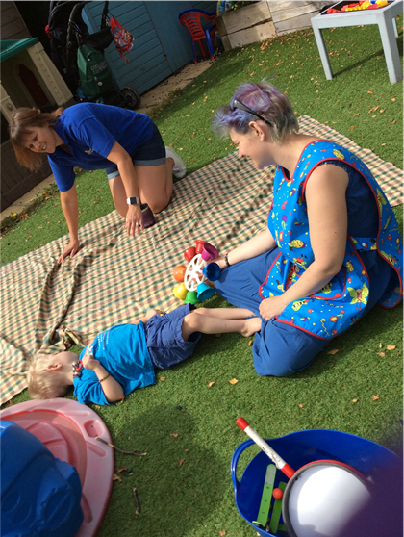
What is the Early Years Inclusion Project?
The aim is to increase the number of young children with SEND accessing early years and childcare places through:
Partnership with Local Authorities
Meaningful Parental Engagement
A National Steering Group
A Comprehensive and Extensive Training Offer
Research shows training and confidence are critical barriers
We want to make a difference and build a movement for greater inclusion in the early years
Notes:
CATH

Slide 6
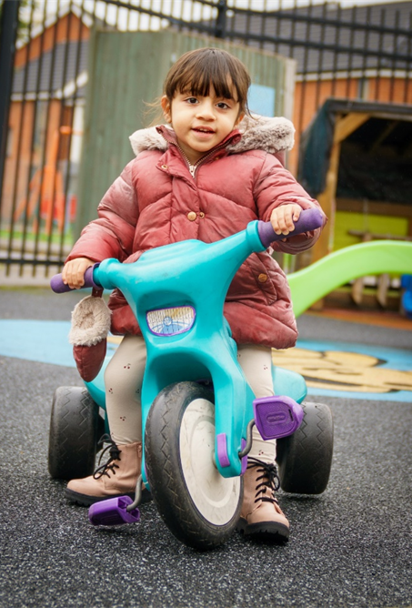
What can we offer you?
Free online training for the whole early year's workforce
10 courses over 5 years including:
Introduction To Early Years Inclusive Practice
Early Years SEND Transitions
Managing Behaviours that Challenge
Having Difficult Conversations with Families
Further 6 courses to be developed
All courses are a mix of workbook, videos and activities
Training can be completed at your own pace
Learning assessed through learners' experiences
rather than a formal assessment.
Notes:
AMANDA

Slide 7

How will it help you and your setting?
You
Enhanced knowledge and skills
Increased confidence in playroom and with families
Hands on experience
Certificate of completion to use in career development
Your setting
Whole setting approach to inclusion – reducing need for 1-1's
Contribute to Ofsted 'Unique child' approach
Better outcomes for children
Improved working with parents
Dingley's Promise Mark of Achievement – Inclusion Friendly Setting
Notes:
CATH?

Slide 8
What are our learners saying?
The videos were common sense, practical, nurturing and holistic. I've been in education 34 years, and they echoed my beliefs and values.
I loved the whole format of this training.
General Feedback
Liked the mix of course material booklet, videos, questions to consider etc, all at my own pace.
I liked that I could access this freely when I could around my other commitments.
Notes:
AMANDA

Slide 9
What are our learners saying?
It gave some good teaching strategies.
Introduction to Early Years Inclusive Practice
I've been working with children under 5 with SEND for 3 years now but I now feel I have learnt things I wasn't aware of before.
I have recommended this course to my peers as I believe it has made me a more patient and understanding practitioner.
It gave loads of insight as to how to help my children develop.
Notes:
AMANDA

Slide 10
What are our learners saying?
I always felt it was my lack of knowledge that made me feel anxious about supporting the current children transitioning to school and it feels good to know that is a normal feeling.
It really allowed me to reflect on my own practice. The content was so current and useful. Would definitely recommend.
Early Years Transitions
Excellent training- thank you. It gave me lots to think about and I will definitely be reviewing some of our policies and how we do things moving forwards.
Really informative. I hadn't considered the perspective of the family as much as I could have.
Notes:
AMANDA

Slide 11

What else do you need to know?
Register at https://dingley.org.uk/dingleys-promise-training/early-years-inclusion-programme/
We'll get back to you within 5 working days to confirm next steps
Please allow about 8 hours to complete each course
For queries or support, please contact training@dingley.org.uk
Notes:
AMANDA

Slide 12

Notes:
BOTH

