Slide 1
Dingley’s Promise Comic Relief Early Years Inclusion Project Measuring Sufficiency for EYs Children with SEND

Slide 2
What will we think about in this session ?
Who we all are and where this work has come from
Our collective concerns
A recap on our collective ideas to measure sufficiency for children with SEND
Questions and discussion – what are you doing, what could you do, how can we help?
Next steps

Slide 3
How shall we work today?
Cameras, mics, joining in and chat
Can you stop the clock and give yourself this time?
Are you comfy?
Who are we all? Please tell us in the chat!

Slide 4
Who are Dingley’s Promise?
- Established 1983 by parents of children with SEND in Reading
- Five specialist early years settings delivering learning through play
- Family support & outreach programme
- Reach around 500 families directly annually
- National training and influencing to build wider inclusion

Slide 5
Training & Consultancy
- Level 3 Certificate in EY Inclusive Practice
- Lockdown & EY SEND Partnership
- Changemakers 5 year project
- Wider influencing
- National EY Specialist Providers Forum
- Creating guidance – EEP, Data driven approach, new EYFS for children with SEND
Notes:
In January 2018 launched Level 3 in EY Inclusive Practice with ncfe
Lockdown – inclusion training 737 across UK – invited to join partnership
EY SEND is what we live and breathe – often SEND without EY or EY without SEND – we bring together
We deliver at our three Centres so training grounded in experience
All Party Parliamentary Group – represent SEND
DCP – represent the early years
Support for LAs and other organisations to promote inclusion in the early years

Slide 6
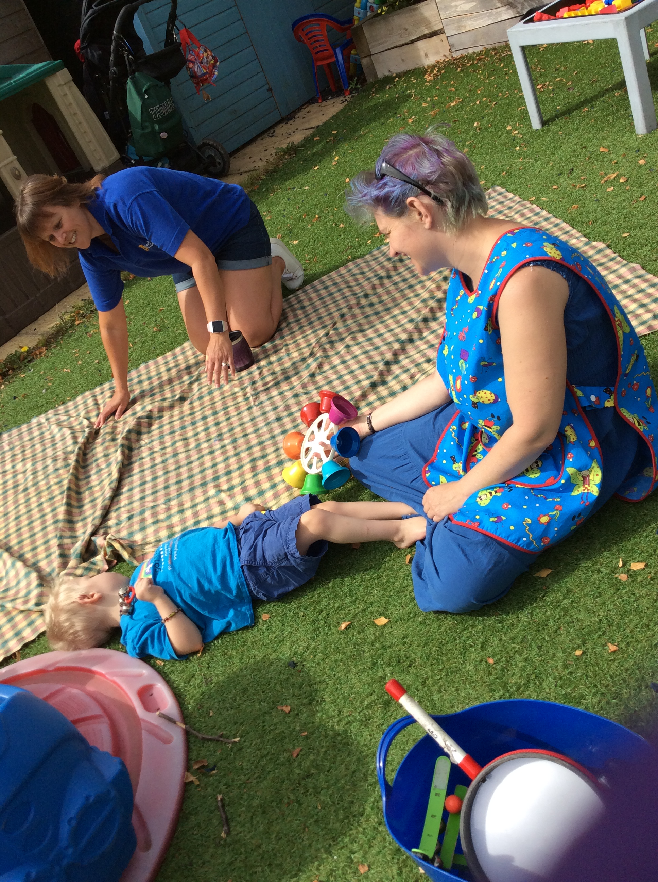
Why the Comic Relief bid?
Children with SEND are not taking up early years and childcare entitlements to the same extent as their peers
There is a shortage of inclusive places
Research shows training and confidence are critical barriers
We want to make a difference!

Slide 7
The aim of the project is… …to increase the number of young children with SEND accessing early years and childcare places through...
Partnership with Local Authorities
Meaningful Parental Engagement
A National Steering Group
A Comprehensive and extensive training offer
Notes:
-

Slide 8
What do families tell us?
“Trying to find childcare was horrific, I ended up seeing my doctor I was so worried about my child, having to give up work and money”
“My mental health was suffering anyway. I needed a break from 24/7 caring and I just kept being told there were no spaces or I had to go through yet another process when other families just got theirs”
“Work was an outlet for me as well as an income source but I had to move my work to weekends which means I cram 20 hrs work into 2 days and have no time as a family”
Parent representatives on the Dingley’s Parent Board

Slide 9
Naming our shared concerns
Pressure on the sector (rising costs and recruitment and retention issues)
Pressure on the public sector purse
The profile of early years locally and allocation of resources
Increased numbers of children with SEND
Are we in danger of widening the gap?
What else? (tell us in the chat)

Slide 10
Why measure?
Legal compliance
Efficient and effective
If you can’t evidence it you can’t change it!

Slide 11
Coram’s annual childcare survey found just 18% of Local Authorities have sufficient places for children with SEND
But
how do you know?
Notes:
https://www.familyandchildcaretrust.org/sites/default/files/Resource%20Library/Final%20Version%20Coram%20Childcare%20Survey%202022_0.pdf

Slide 12
Measuring Sufficiency for Children with SEND
Typically, your CSA’s will analyse information for the whole population of 0-14/16 year olds;
Socio-demographic data (usually to locality level)
Employment and workforce trends
Analysis of supply and demand, present and predicted using:
Questionnaires and feedback from providers
Questionnaires and feedback from families
Local intelligence for example feedback from the
Family Information Service (or equivalent), parents,
Job Centre Plus etc.

Slide 13
But…
When we looked at lots of CSAs we found that even where insufficiency was reported:
There was no specific methodology for measuring supply and demand for children with SEND
But specific sections told us what you will do, but not how you know if you are sufficient
And..
Impact information was missing too
Yet…
We know children with SEND are not accessing their entitlements
We are required to secure provision in law

Slide 14
Are you specifically measuring sufficiency for children with SEND in the Early Years?

Slide 15
It’s complicated!
How do we measure the number of children with SEND?
How do we accurately measure supply when we hold our sector to account for inclusion?
How do we take account of parental entitlements, expectations, wants and needs?
How do we ask the questions without planting the wrong seeds?

Slide 16
Measuring demand
Your total population of children in the EYs
Live emerging and additional needs
Tracking back to triangulate and understand the journey and impact
Breaking down into those who accessed specialist and mainstream
Parent/carer consultation
Complaints, whistleblowing, intelligence from partners
Understanding needs and impact – EYPP, 2YO data, deferred entry to school, part time entry, socio demographic data etc.

Slide 17
Measuring supply
Places available for the whole population (Ofsted downloads)
Specialist places?
Questionnaires - inclusive places or places business planned for?
If you can’t can someone else ask for you?
Intelligence from ongoing conversations

Slide 18
Discussion
What are you doing already?
What could you do?
What are the challenges?
How can we support you?

Slide 19
Resources to support you
Our Ideas Paper
Our LGA webinars and case studies to share
Aimee Trimmer from Reading
Emma O’Neil from Swindon

Slide 20
Review of EY SEND provision in Swindon: What happened next?...
March 2023
Emma O’Neill

Slide 21
Context
Project aimed to bring together EY SEND services under LA.
A strong business case was needed to evidence levels of demand as an increase in investment was required.
Initial data set was gathered using children in YR, 1 and 2 with an EHCP. A more detailed analysis of children in Y1 was carried out to identify their access to EYFS entitlements.
Using this data a business case was produced, outlining a restructure and expansion of existing services. This was agreed in October 2022.

Slide 22
Findings of the review
Of the children entitled to 15 hours 46% of children with an EHCP accessed their full entitlement, compared with 84% of children without an EHCP
Of children entitled to 30 hours 60% of Children with an EHCP accessed their full entitlement, (however this is a very small number of children), compared with 68% of children without an EHCP. The smaller gap between the numbers entitled to 30 hours may also be indicative of parents taking the decision not to work because of childcare issues connected with their child’s additional needs. The view that parents with children with additional needs do not feel able to work full time, due to childcare challenges, was expressed widely by the parents involved in the review.
10% of children did not access any of the entitlement at all
This information may also present an overly optimistic picture, as we believe that there may have been settings claiming a full 15 hours funding, but only accepting the child for fewer hours and using the additional funding to fund additional support for the child.

Slide 23
52% of children were also entitled to 2 yr old funding
Of the total 289 children with an ECHP who were tracked, 229 (almost 80%) of them had accessed Early Years Pupil Premium which demonstrates a disproportionate amount of disadvantage in this group.
It also appears that 12% of the children attended 4 or more settings (some in one day or week) which is both unusual and may indicate a problem. We also know transitions can be very difficult for children with SEND and their families and this may indicate the juggle families are facing and potentially an insufficiency of places.

Slide 24
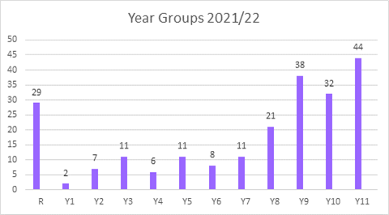
Children in Y1 with EHCPs by postcode
Numbers of children on part time timetables by year group
Postcode | Percentage
SN1 | 11%
SN2 | 25%
SN25 | 17%
SN26 | 1%
SN3 | 32%
SN4 | 2%
SN5 | 7%
SN6 | 2%

Slide 25
SEN Primary Need | Number |  | Percentage
Autistic Spectrum Disorders | 44 | 49.44%
Soc, Em and Ment Health | 7 | 7.87%
Physical Disability | 8 | 8.99%
Severe Learning Difficulty | 4 | 4.49%
Speech, Language and Comm Needs | 19 | 21.35%
Visual Impairment | 1 | 1.12%
Speech, Lang or Comm Diff | 3 | 3.37%
Hearing Impairment | 1 | 1.12%
Profound & Multiple Learn Diff | 1 | 1.12%
Specific Learning Difficulties | 1 | 1.12%
 | 89

Slide 26
So what!
Based on the data a business case was agreed to remodel the service, adding capacity as well as a second site, based in the area with the greatest level of need.
(This is still very much a work in progress!)

Slide 27
Type of support | Current model | New model
Hours of EY educational entitlement | 3040 | 14592
Portage home visiting sessions | 10 | 18
Potential reach of service (number of children and families) | Education sessions 32 families | Education sessions – up to 128 children & families
Early Help support (Lead Professional role/TAC meetings) | Minimal. Dependent on staff being able to be released & working in own time | Minimum of 60 hours per week
Paperwork (referrals, EHCNA applications, Advice for EHCPs…) | 9.5 hours per week and significant amount of additional time in staff’s own time | 30 hours
Outreach to mainstream | Minimal. Dependent on releasing staff, staff goodwill and work in their own time | Minimum of 60 hours
Support for parents (training courses & support groups) | 18 families | At least 36 families – potential for more

Slide 28
Current position within the service
Development of “Assessment Centre” model
Recruitment of staff (very positive!)
Plans for new location as well as continuing in current location are underway
More effective team working, less inefficient ‘silo working’. This is work in progress.
Childcare sufficiency assessment is currently being carried out – specific focus on SEND

Slide 29
Moving forward
Development of a ‘less messy’ and more efficient data set! (based on what we originally did)
Ensuring the quality of the service is maintained in spite of the rapid growth. This will include robust QA.
Development of measures of success beyond hard data:
Parent voice
Mainstream provider feedback
Transition evaluation

Slide 31
Next steps you can take
Create a baseline and start measuring now!
Use our Ideas Paper to facilitate conversations with your data and service leads
Make your business case - engage your managers and decision makers (identify your champions and build relationships)
Engage your parents and carers
Engage the sector
Use the resources – presentations and recordings from us, Reading and Swindon
Think about the “so what?”

Slide 32
What do parents tell us?
“My child needs to socialise and have these experiences more than other children not less”
“It felt like me and my child were being rejected over and over”
“What happens to the parents who are not articulate and confident enough to complain?”.
Parent representatives on the Dingley’s Parent Board

Slide 33
What will you do next to measure what’s happening?

Slide 34
Thank you for your passion and commitment!
ann@annvandyke.co.uk
catherine.mcleod@dingley.org.uk

