Slide 1
Business Strategy
A vision for 2020

Slide 2
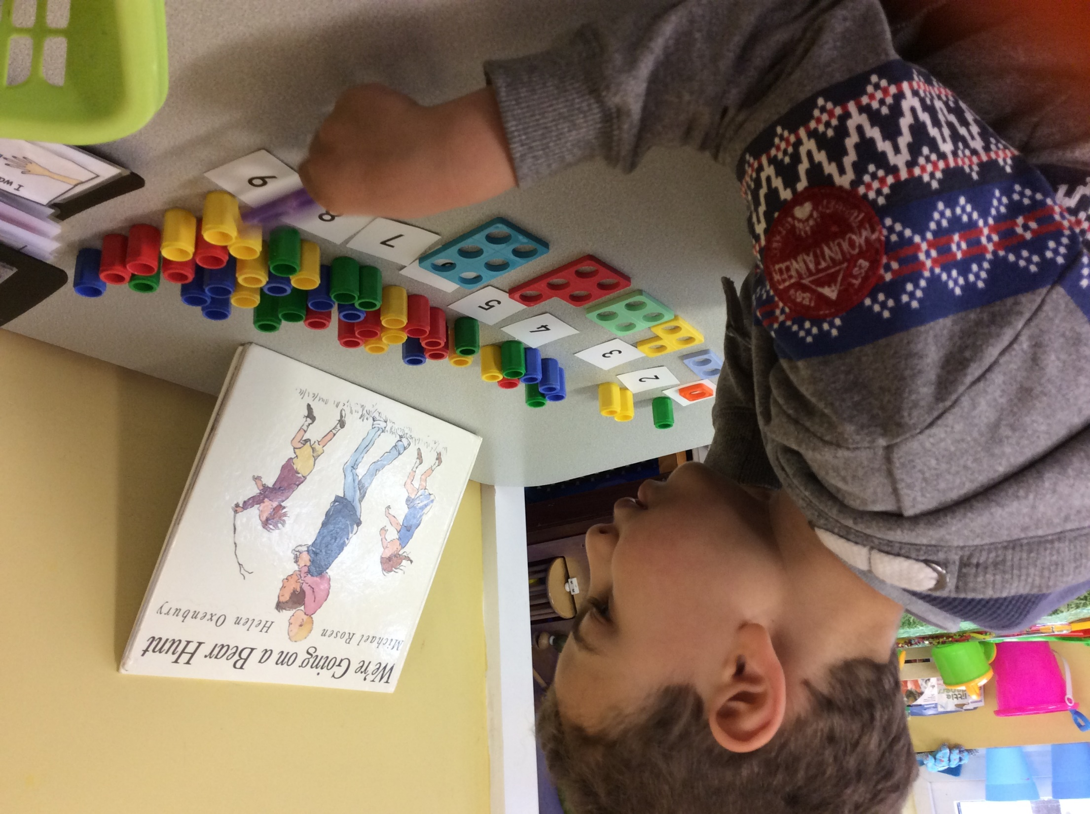
Vision
‘The best start for every child.’
Notes:
Purpose – this is more like a mission – purpose is our specific part of the vision.

Slide 3
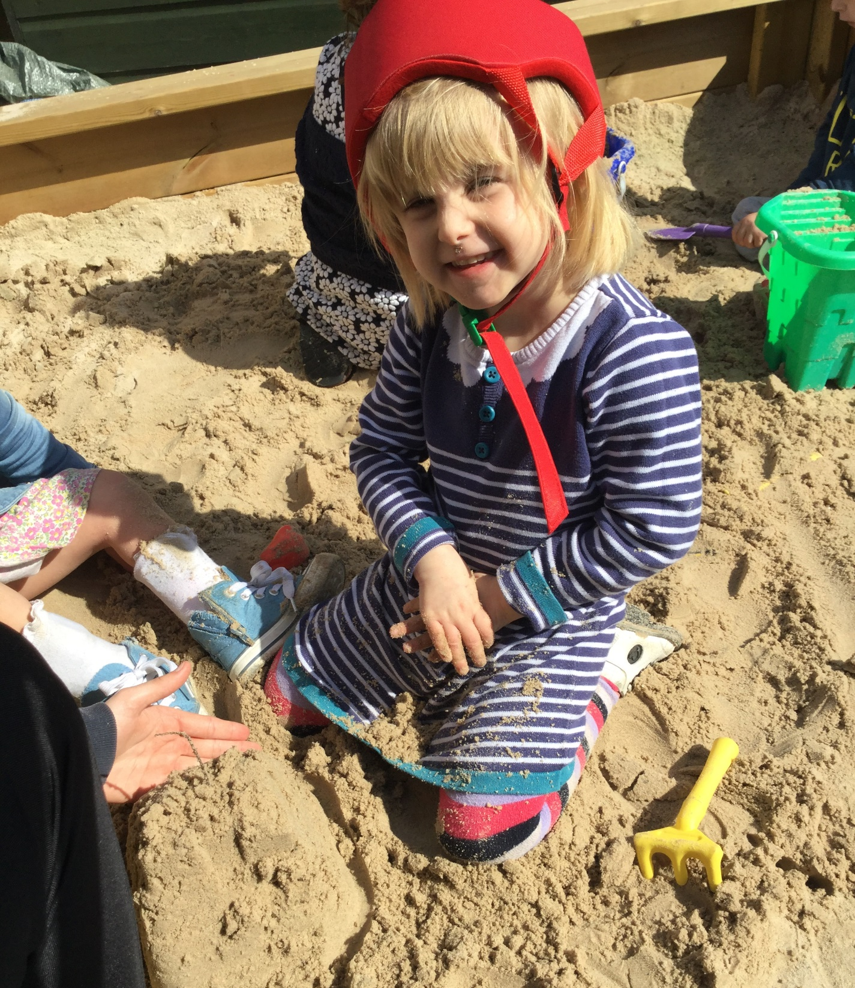
Mission
‘We deliver life changing support to under 5’s with additional needs & disabilities and their families, by providing specialist learning through play, family support & training, and advice to mainstream settings.’

Slide 4
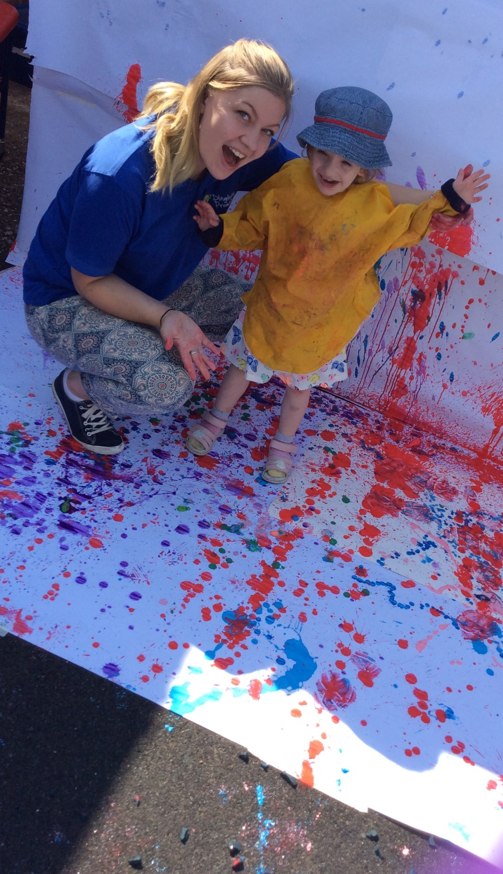
Our Core Services
Activities for Children - Learning Through Play (LTP) sessions for children with additional needs & disabilities, including those with complex medical needs and life limiting conditions.
Support for families - listening, signposting, supporting at meetings, joint sessions with professionals, home visits, stay & play.
Providing advice to mainstream settings. PASS service, visits, training for practitioners.
Notes:
Information gathered at staff conference and through one to one staff discussions.

Slide 5
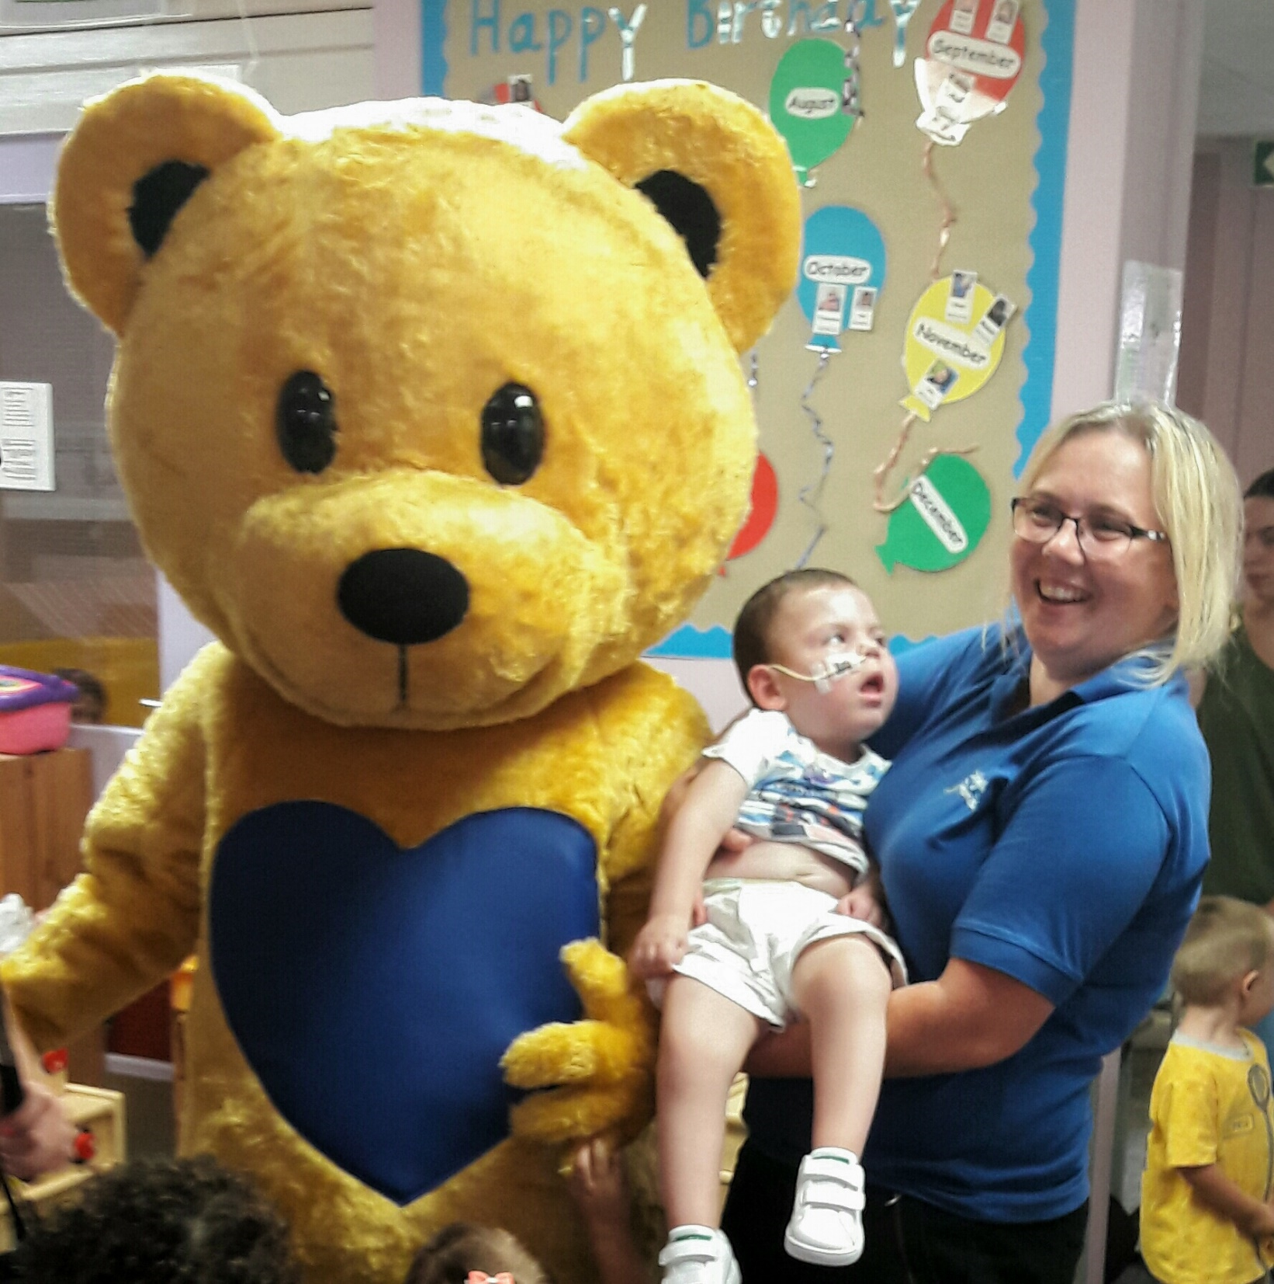
Our Core Values
We seek excellence in all we do through continuous learning and improvement.
• We care for each other, our children and their families.
• We promote development of children, families & our team in a stimulating environment.
• We work with integrity, sharing resources and expertise for best outcomes.
• We empower children and families to make their own choices.
Notes:
Dingley way ideas from staff and stakeholders views.

Slide 6
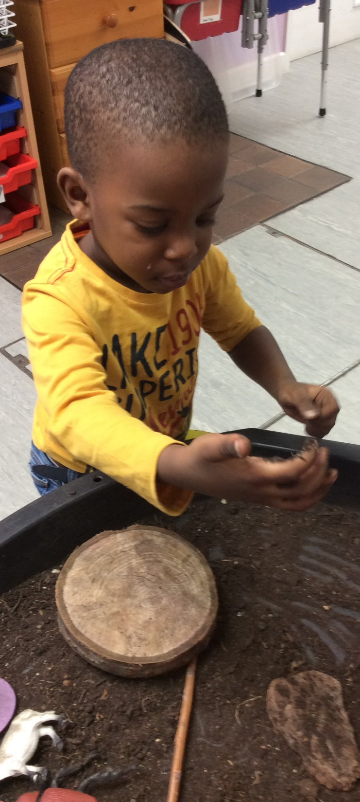
Our Unique Selling Points
Preventative role in reducing gap between children with SEND and their peers, allowing more to enter mainstream education - we use specialist early intervention to build greater inclusion.
Spreading good practice around meaningful inclusion - a local charity with a national impact.
Much-needed regular respite for parents of children with SEND in the early years.
Ability to include children with complex medical & life limiting conditions who have been excluded elsewhere.
Notes:
General expectation of charities working towards inclusion – CMs say in past more able children have stayed but they want more able to also experience mainstream – shared numbers rising. Not only better for long term goals of child, but helps us to reach more children. (currently 32% of children do this)

Slide 7
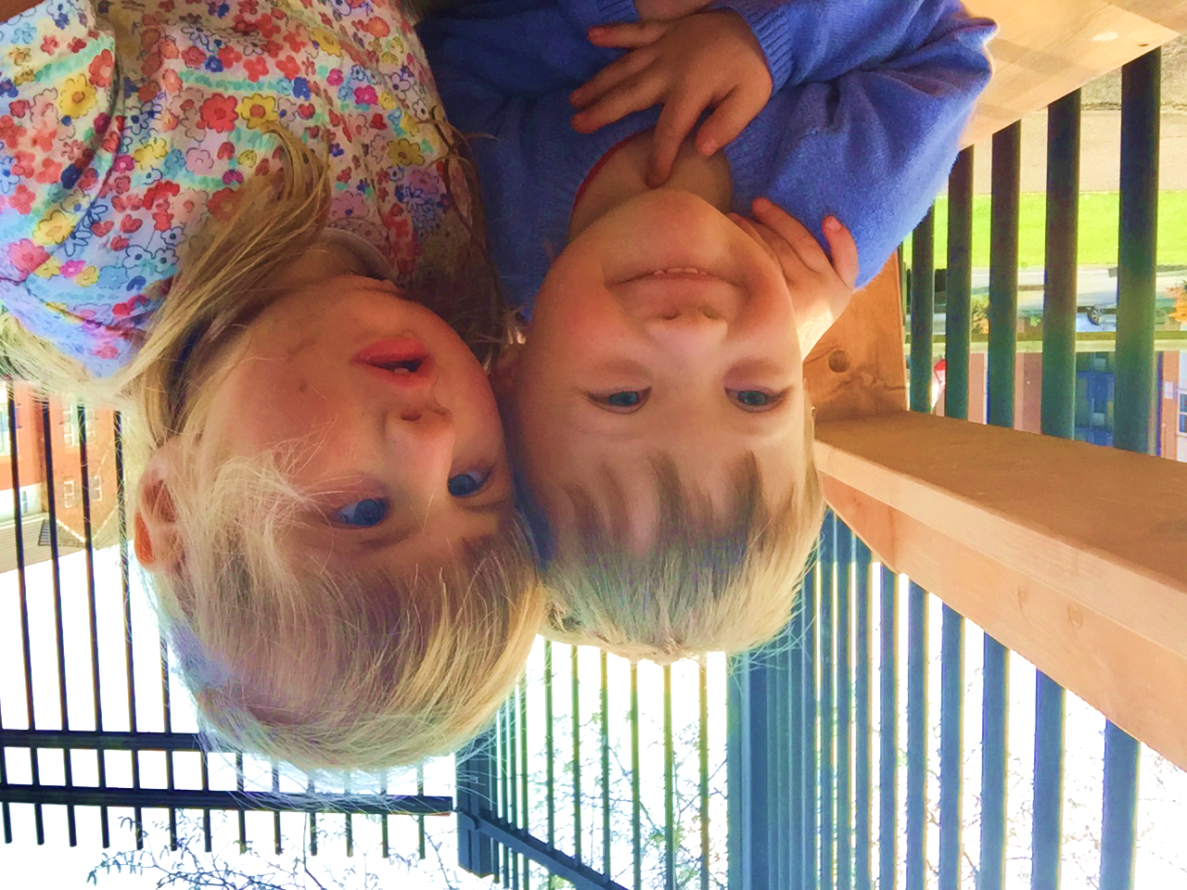
Our Objectives
Ensure every child transitions to the best educational option for them when they leave Dingley’s Promise.
Ensure all of the families’ needs are met by effectively networking and signposting.
Reach as many children as possible through direct services and building wider inclusion.
Ensure staff wellbeing is at the core of what we do.
Notes:
Initial thoughts only – will come back to these later

Slide 8
Our Development Strategy
Ensure every child transitions to the best educational option for them when they leave Dingley’s Promise.
Ensure all of the families’ needs are met by effectively networking and signposting.
Establish clear entry/ exit criteria to ensure a targeted programme for each child.
PASS to support mainstream settings to be able to accept our children.
Actively develop partnerships with schools for effective transitions.
Support families to access shared provision and to access their 30 hours if eligible
Actively build complimentary partnerships with service providers – local and national

Slide 9
Our Development Strategy
Reach as many children as possible through direct services
Reach as many children as possible through building wider inclusion
Expand to at least one new county
Expand open access services, establishing external sessions in addition to Centre-based
Promote our model nationally
Establish HQ/ hub to lead change
Establish trading subsidiary to run training offer
Support others looking to set up a similar service

Slide 10
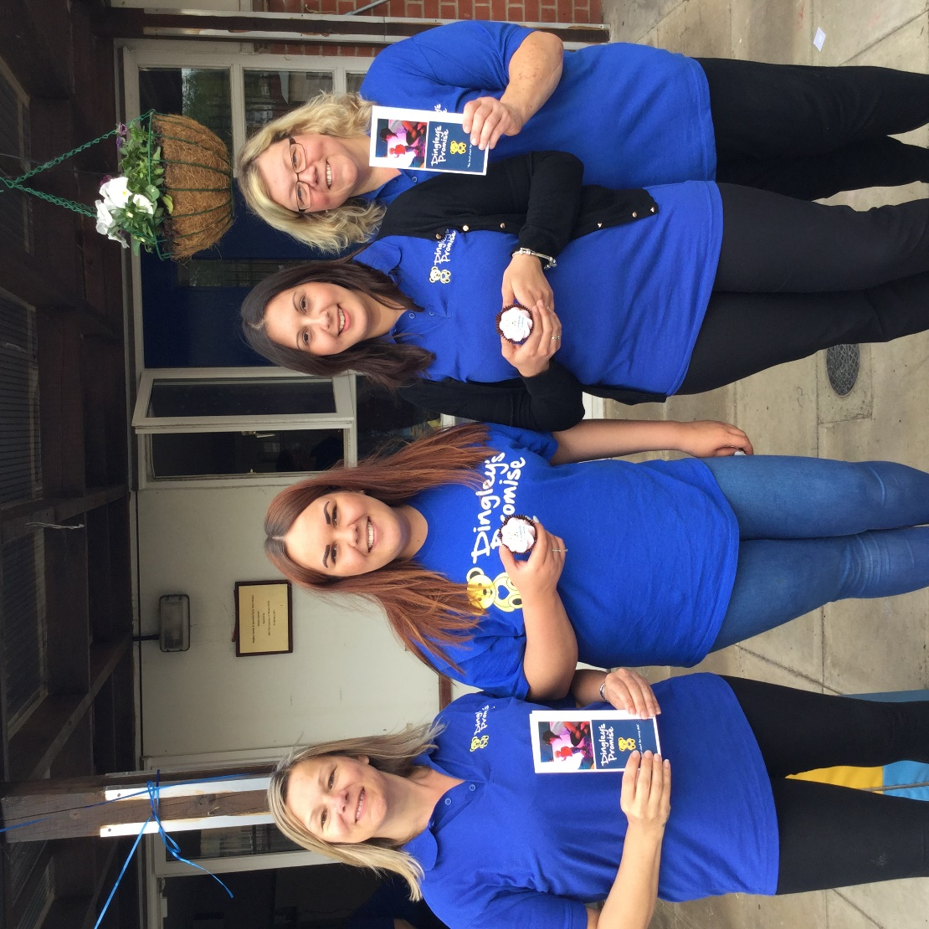
Our Development Strategy
Ensure staff wellbeing is at the core of what we do
Embed the five ways to wellbeing
Introduce Employee Assistance Programme
Establish opportunities for regular wellbeing sessions

Slide 11
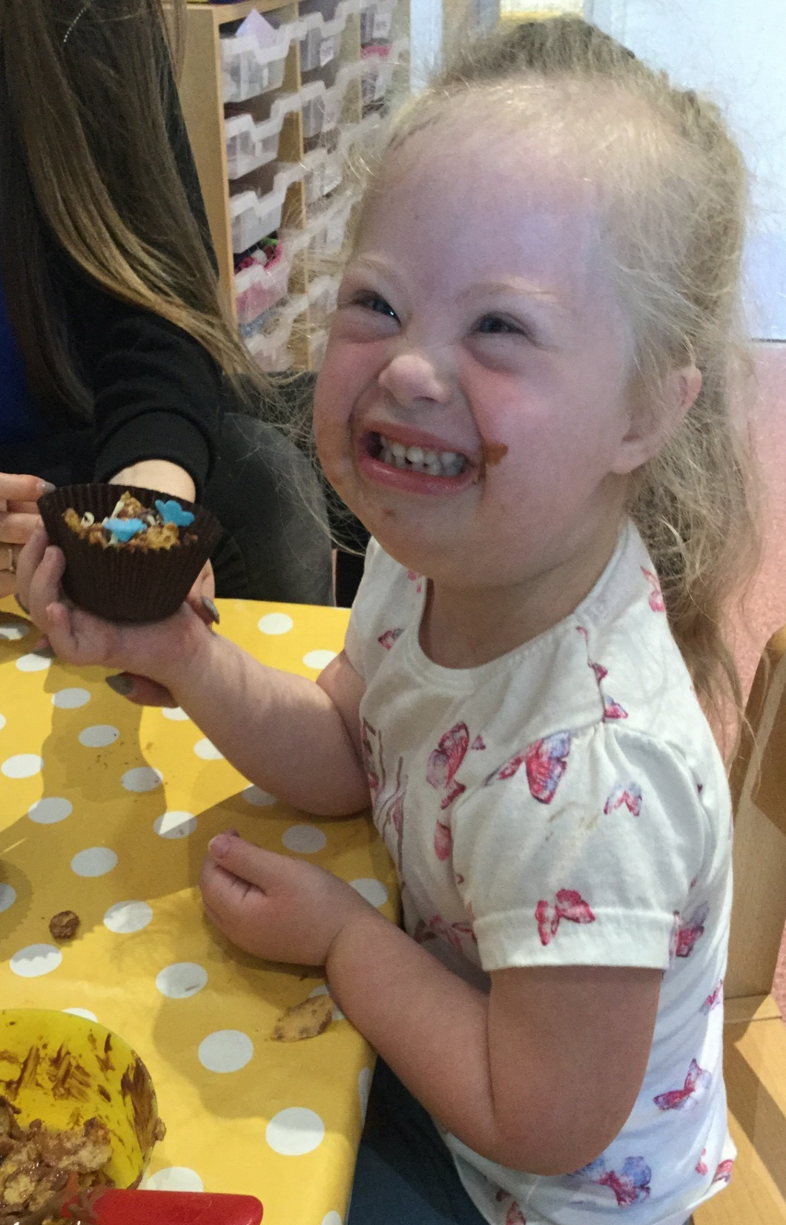
Expected impact by 2020
LTP sessions remain core activity, growing as we reach new areas and new children.
We will reach at least 250 children per year through direct services, and at least 75 mainstream settings per year through training.
We will be delivering sessions in more than one county and providing training to settings across the country.
We will be an active signposting and lobbying organisation working effectively in partnership with other local and national organisations.
Our model and expertise will be recognised nationally, and we will have helped at least 2 new local authorities to improve practice.

